Slide 1
RESEARCH PAPER PRESENTATION
"Role Of Social Worker In Community Development During Covid-19"
(Nagaapur, Tal. Nagar, Dist. Ahmednagar)
Researcher
Amol Devilal Rathod
Center for studies in rural development –
Institute of social work and research, ahmednagar
Mo.no. 9146841494
E-mail: amolrathod@csrd.edu.in

Slide 2
BACKGROUND OF THE AREA
Total population : 762
Total families : 149
Persons infected with the corona so far : 102
Persons currently infected with corona : 17
A person who dies of covid : 15
The person who died in the household : 04
Problems created in the community due to covid :
  Educational problems
  problem about employment,
  depression, psycho problems,
  fear about vaccination and covid,
  Problems with subsistence.

Slide 3
METHODOLOGY
This research paper is based on the activities and research done in the field. It uses surveys, group discussions, observations, interviews, case studies, etc. and tries to present the findings in this research paper.

Slide 4
Intervention
Situational Analysis & Research
Covid 19 Awareness Camp And Health Checking Camp
Covid 19 Vaccination Awareness And Vaccination Camp
Poster Making About Covid 19
Formulating Anganwadi Worker Team And Conducting Baseline Survey
Identify Very Affected People, Weaker Section Of The Community
Mentally And Emotionally Support Of Depressed People
Visited Covid Death Families.

Slide 5
Continue..
Social and economical support to the needy families
formulating student groups whose loss their education in pandemic
Case work with the mentally affected people in pandemic

Slide 6
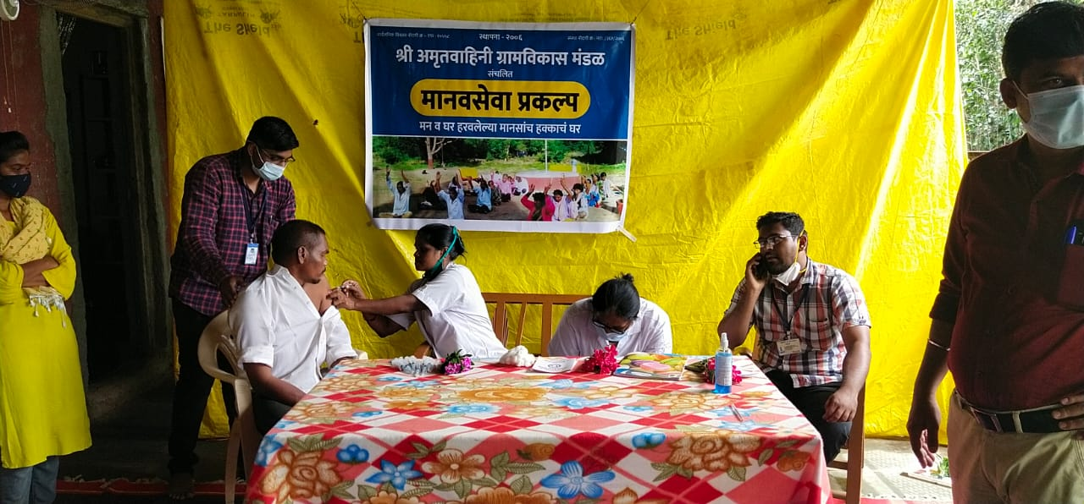
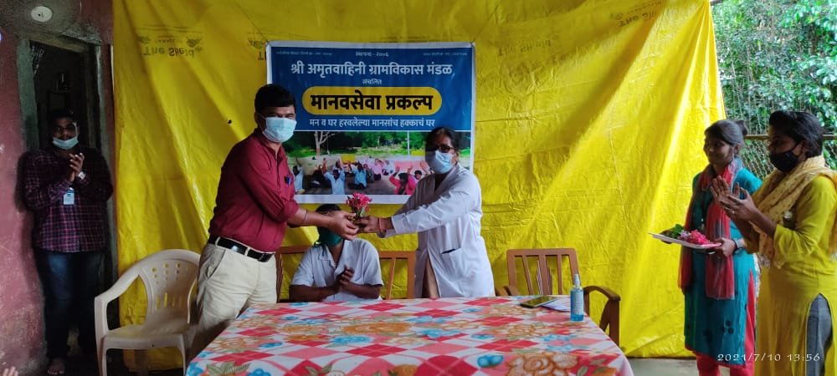
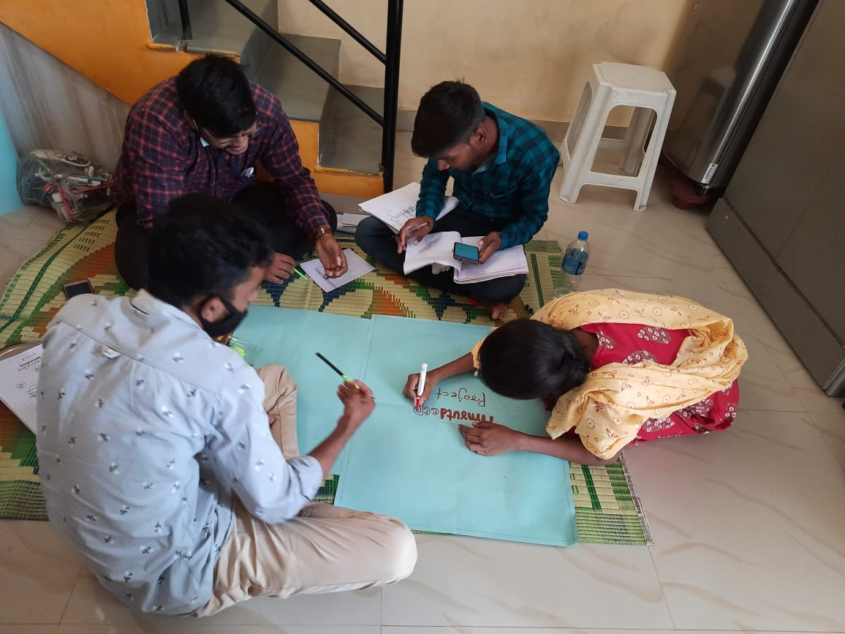
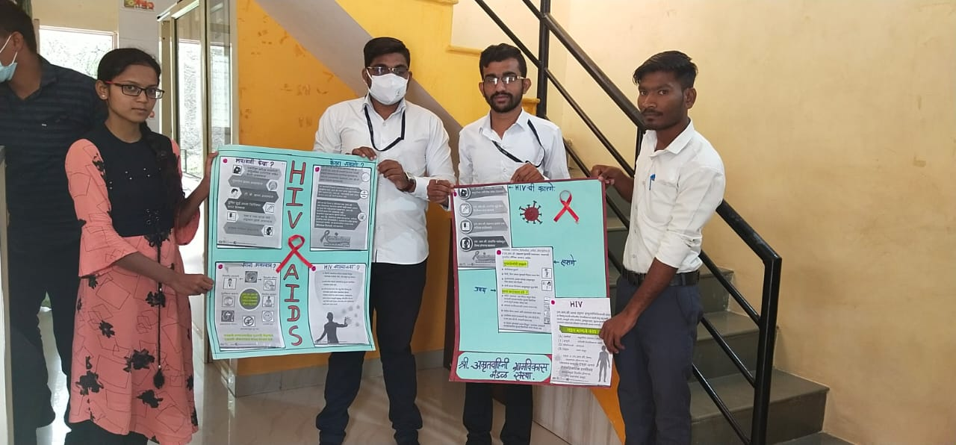
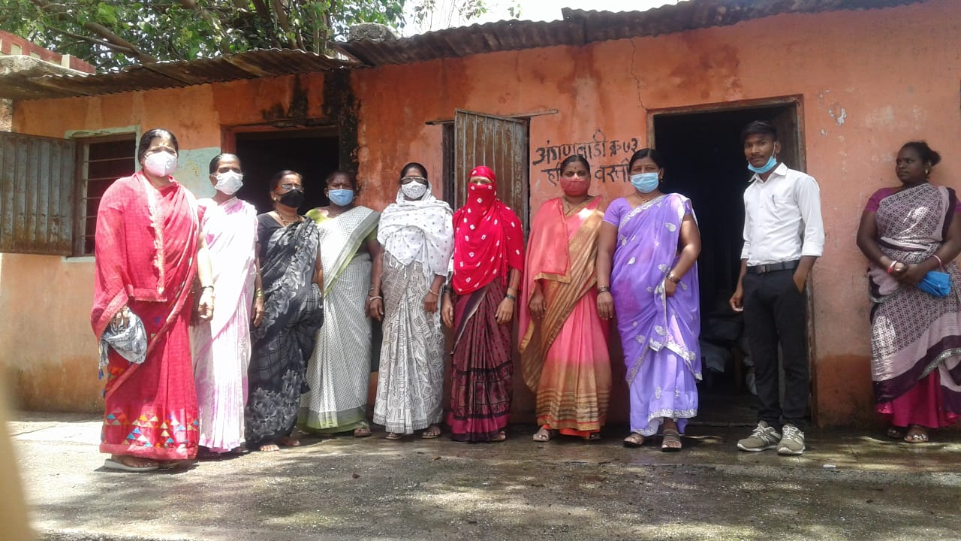
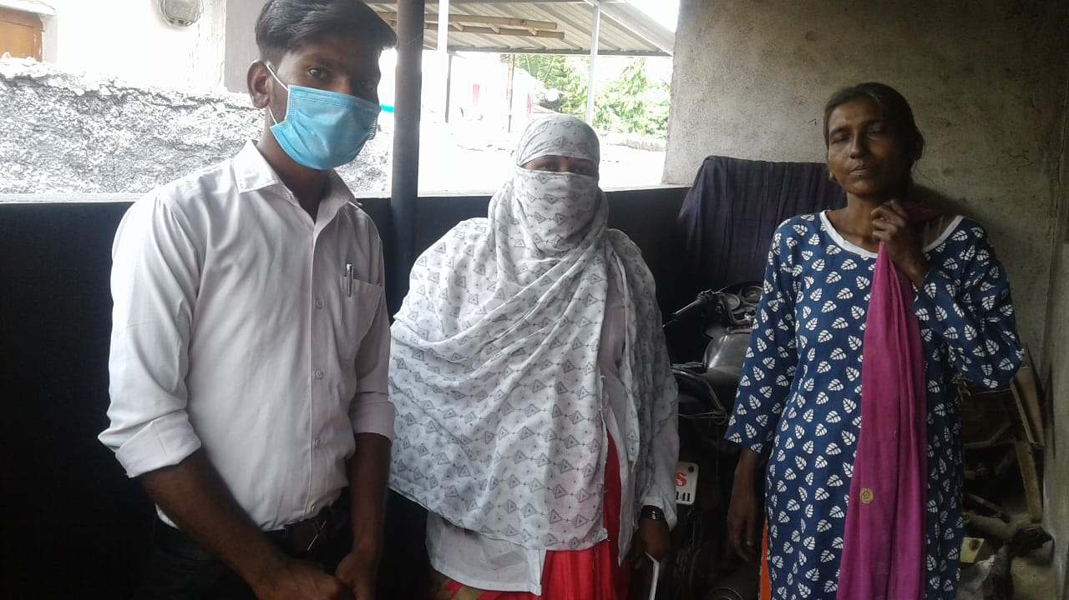
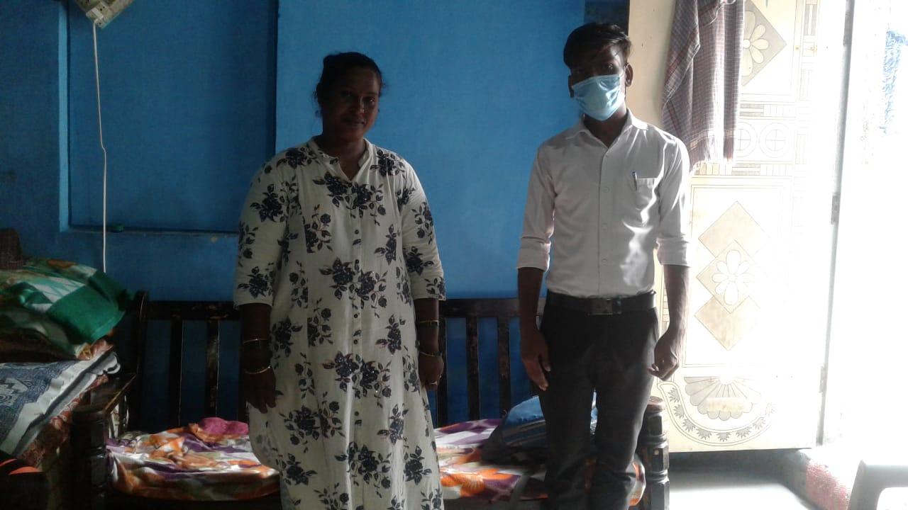
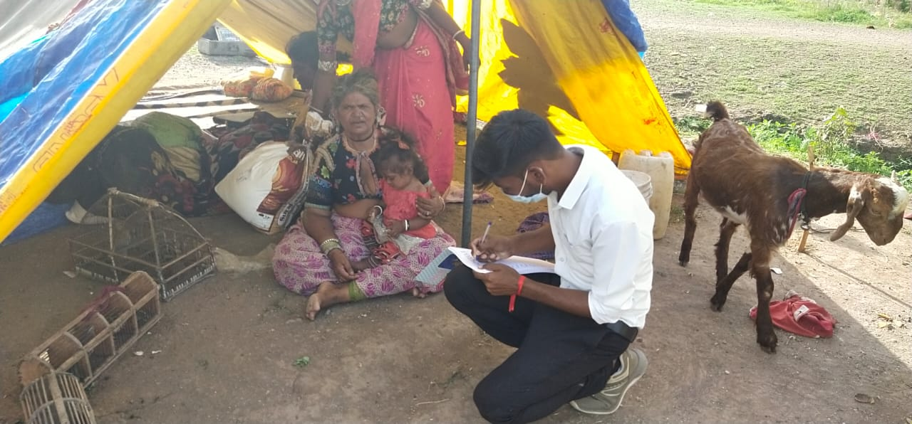

Slide 7
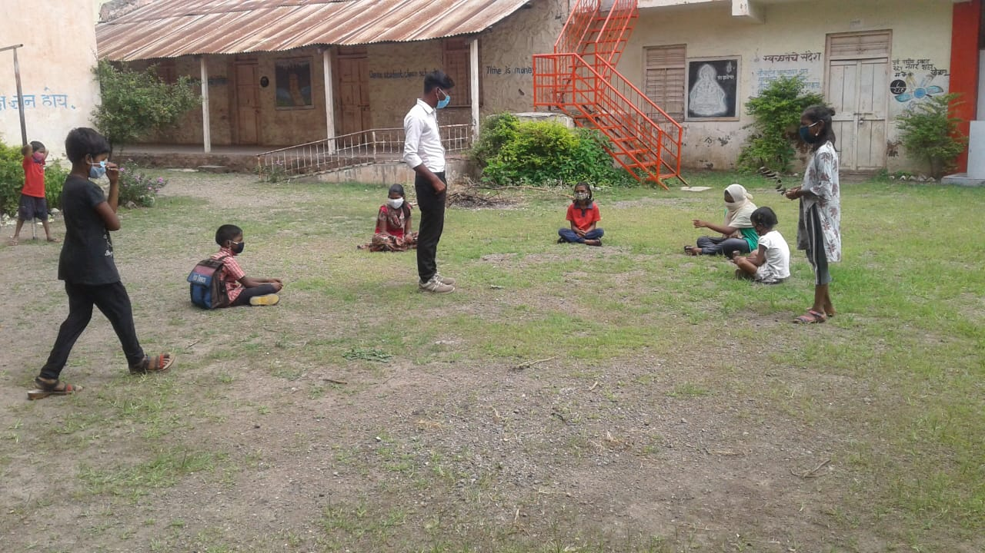
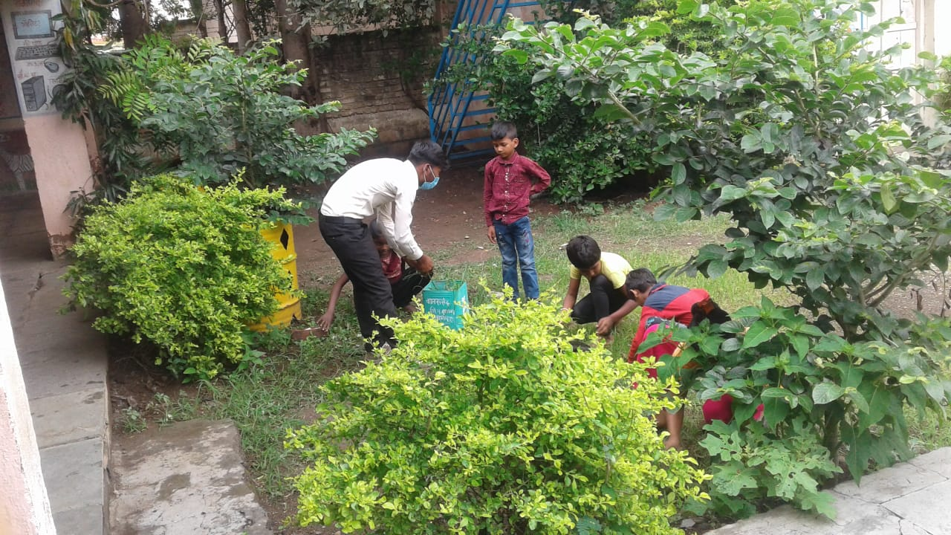
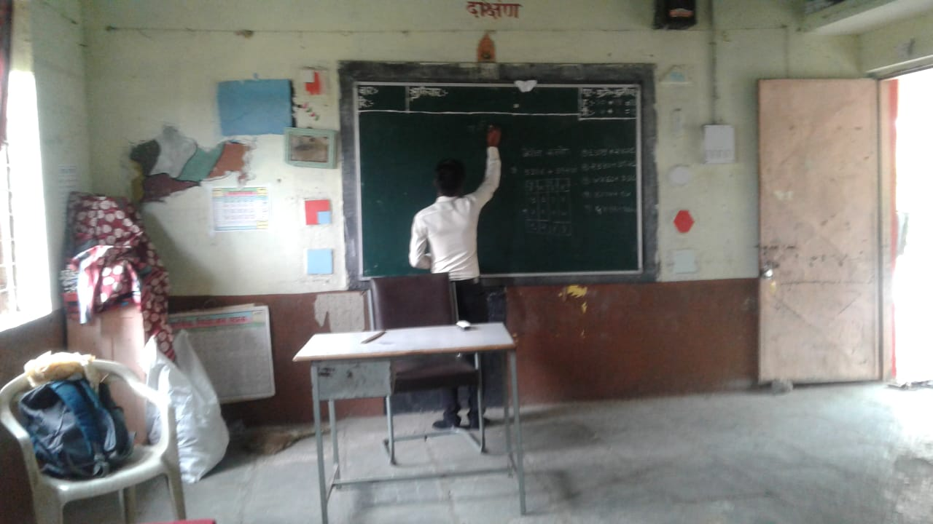
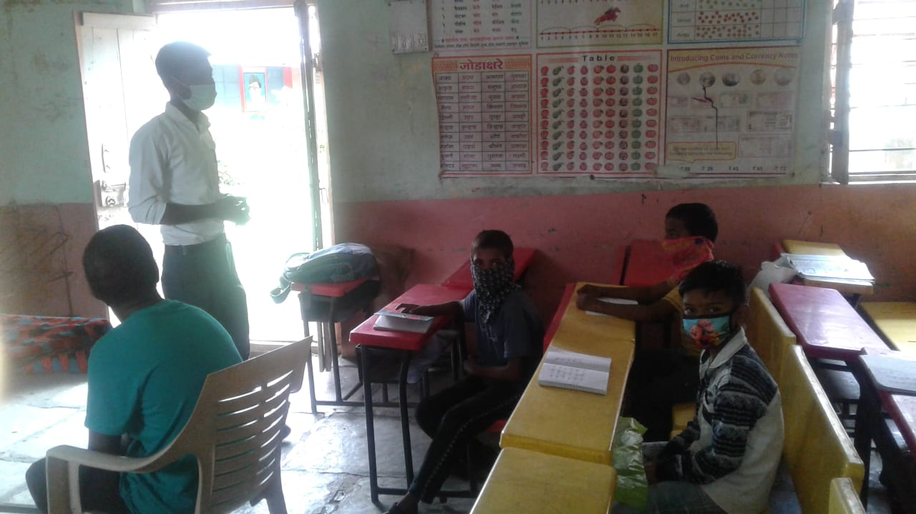
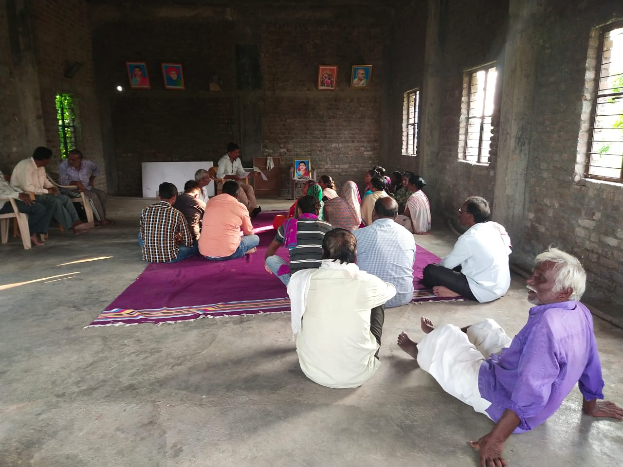
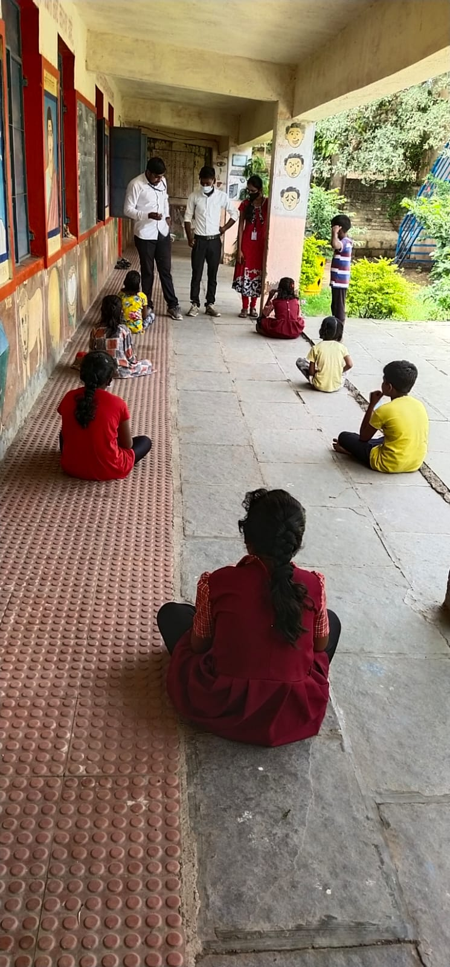
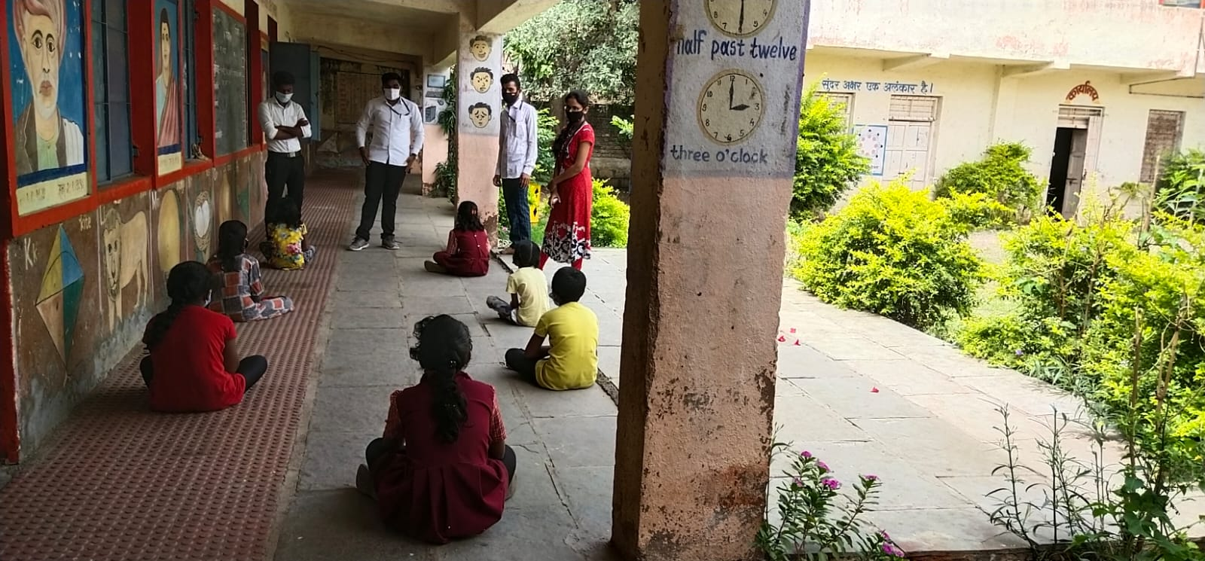
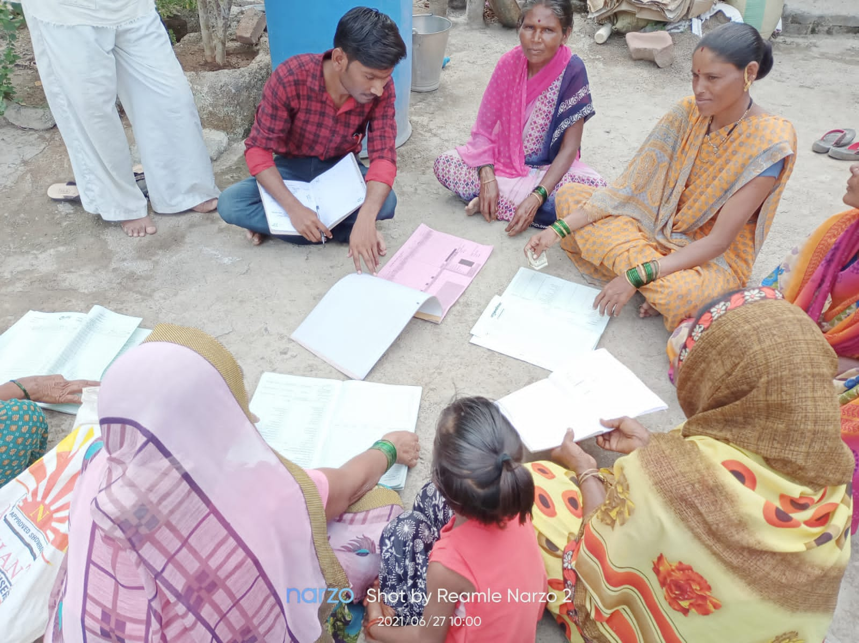
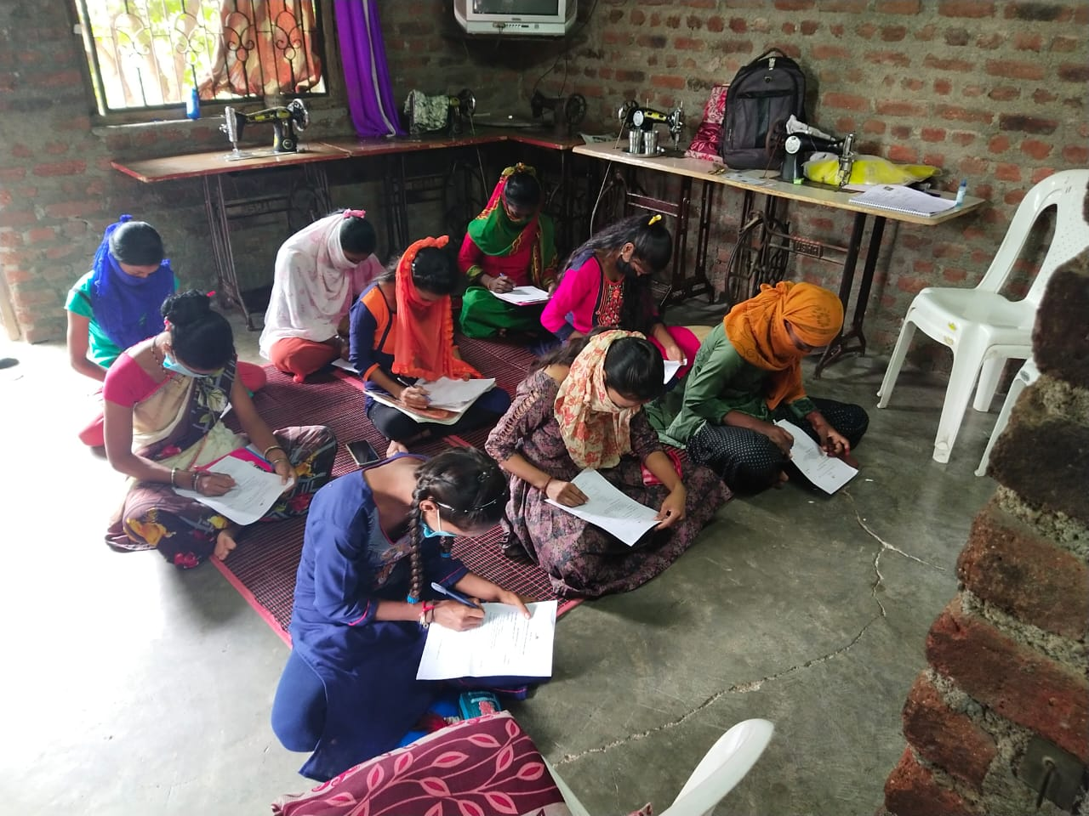
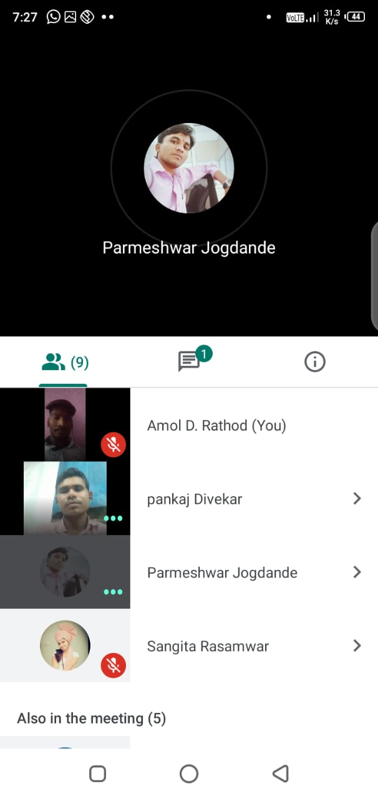
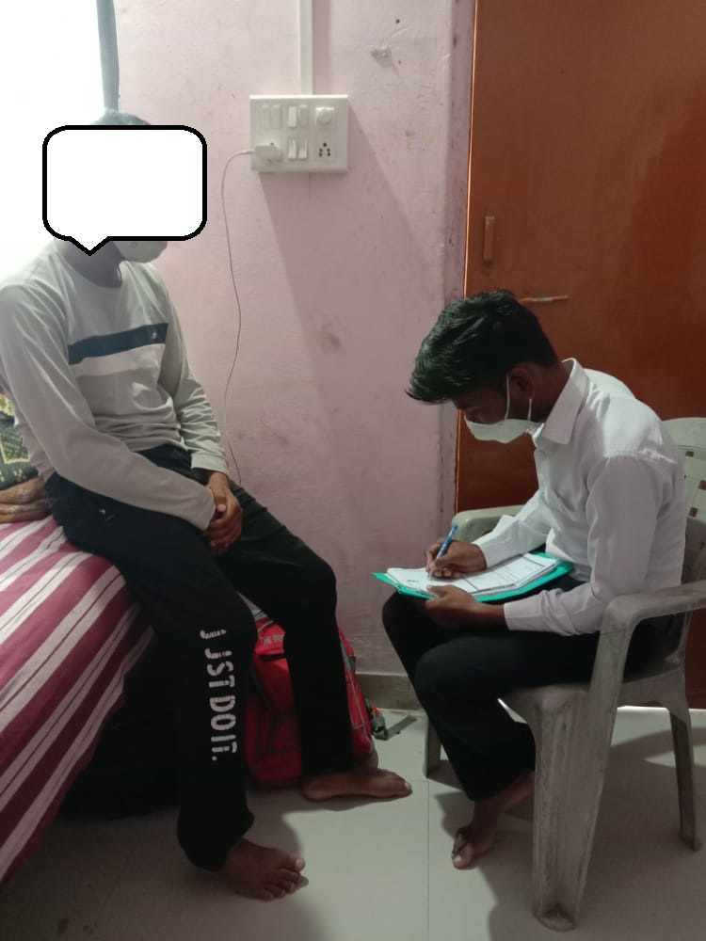
Social work intervention

Slide 8
FUTURE PLAN
Effect of covid-19 | Created networking/ collaboration
Educational effect | Model school
Financial effect | Amrutvahini
Employment | Snider, classic wheel, Exide battery etc factory
Mentally effect | Primal foundation – telephonic counselling
Vaccination | Maya care foundation
Weaker section / very affected people | Grampanchayt

Slide 9
OUTPUTS/ OUTCOMES
  People benifited from the awareness programme : 117
  People taken for vaccination by you :117
  People benefited from counselling : 42
  Giving employment : 20
  Education fasilities : 22 student
  Fullfill basic needs of the community
  Skill training : 30
  Leadership created in the community
  The fear in the minds of the people vanished about vaccination
  Women became financially capable
  There was a change in the people in the community.
  The stressed person became stress free

Slide 10
CHALLENGES FACED DURING THE INTERVENTION
It Became Difficult To Encourage People To Get Vaccinated.
Difficulty In Implementing action plan
There Were Difficulties In Using Some Methods Of Social Work.
Difficulty In Matching Resources / Financial Resources

Slide 11
REFERENCES
डॉ. पवार दत्ता, (२०१७) ग्रामीण विकासासाठी समाजकार्य, दूर व मुक्त अध्ययन संस्था : मुंबई विद्यापीठ
राठोड अमोल, (२०२१) कोरोना विषाणूच्या सामाजिक आर्थिक परिणामांचा अभ्यास, सी.एस.आर.डी. अहमदनगर
टांकसाळे प्राजक्ता, (२००९) व्यावसायिक समाजकार्य, विद्या प्रकाशन: नागपूर
Ahemadnagar cencus report 2011 assessed on 28/07/2021 at 11:32 am
The indian journal of social work, (2018) valume 79 : TISS Mumbai

Slide 12

If you can dream it, you can do it………

