Slide 1
TITLE : THE ROLE OF ICDS IN THIS PANDEMIC SITUATION
PRESENTED BY
ANUJ SUNIL BANSODE
CSRD-ISWR AHMEDNAGAR

Slide 2
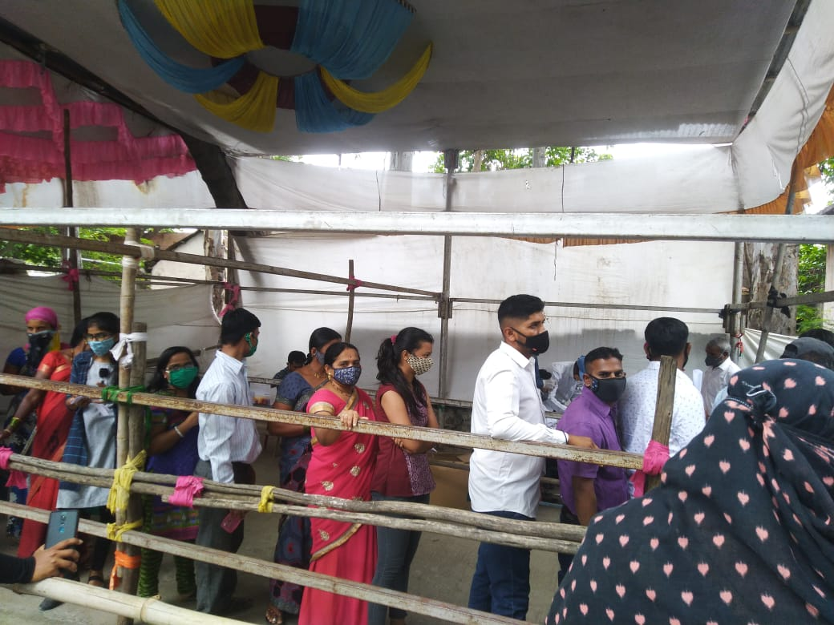
CORONA VACCINE REGISTERATION

Slide 3

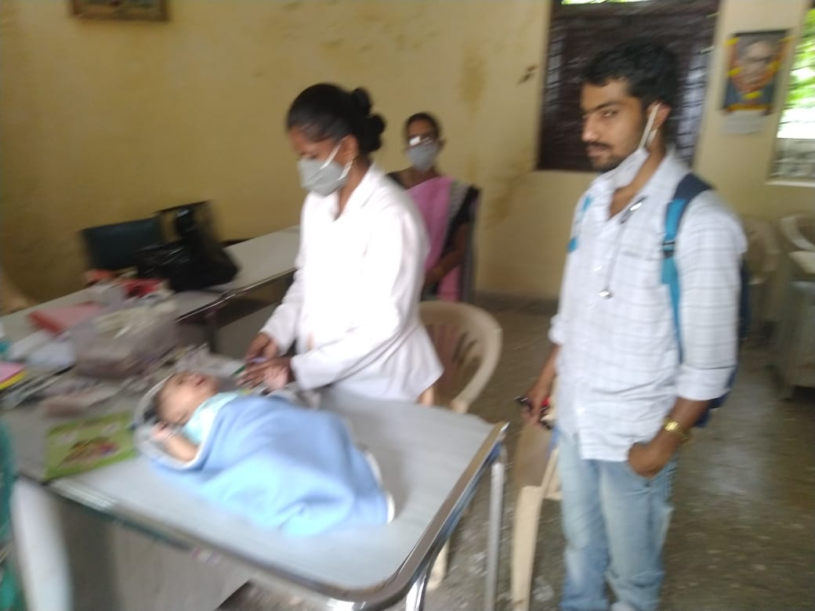
POLIO DOSE REGISTERATION

Slide 4
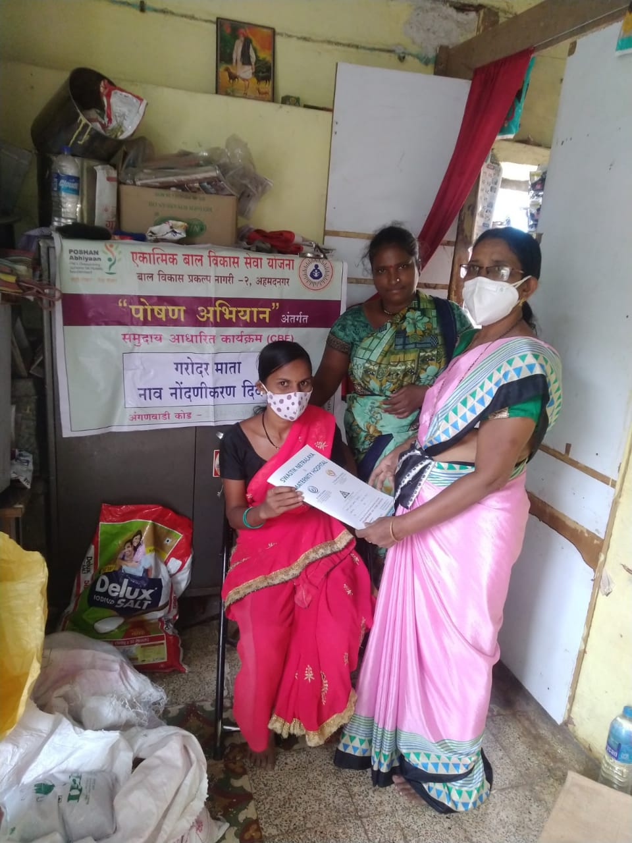
AWARENESS ABOUT POSHAN AHAR ABHIYAAN POLICY

Slide 5
CHALLENGES
1) SOME RESPODENTS REFUSE TO TALK TO US
2) THERE IS MISMANAGEMENT OF RESOURCE
3)DOMESTIC VIOLENCE
4)INADEQUATE EMERGENCY SERVICES

Slide 6
OBSERVATION & LEARNING
OBSERVATIONS
1) LACK OF EDUCATION
2) INFORMAL ECONOMY, WITH MANY EMPLOYING THEMSELVES
3) NO ACCESS TO POTABLE DRINKING WATER, & WASTE MANAGEMENT
4 LACK OF SANITATION AND ACCESS TO MEDICAL FACILITIES
LEARNING
1) UNDERSTANDING ABOUT THE SOCIAL PROBLEM
2) ANALYZATION SKILLS
3) ABILITY TO MAKE SOLUTIONS
4) PLANNING SKILLS
5) CULTURAL VALUES
6) COUNSELLING SKILLS

Slide 7
THE END

