Slide 1

CSRD-Institute of Social Work and Research,Ahmednagar.
Name : Kute Sonali Pandurang
Name of the fieldwork community: Madhi,Tal:Pathardi,Dist:A.nagar
Name of The fieldwork supervisor: Prof. Vijay Sansare sir
Duration of fieldwork: 22 feb to 31 march 2021

Slide 2
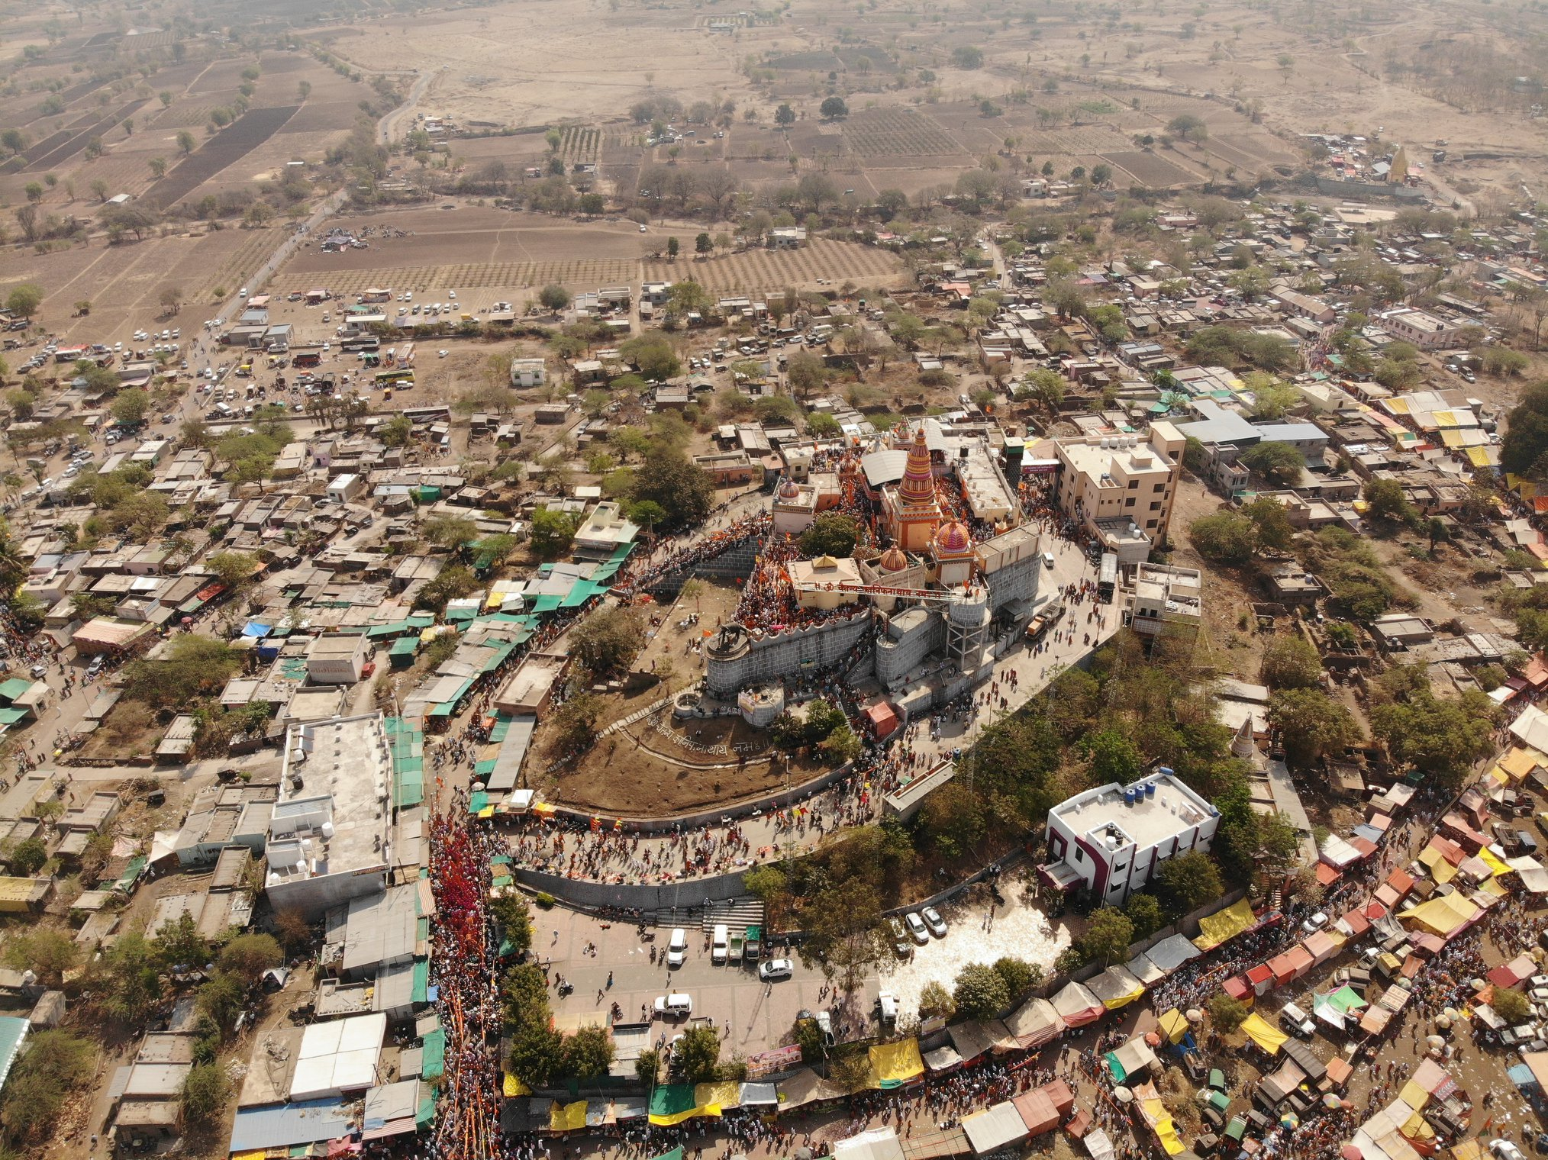
Fieldwork place
The fieldwork place that I have choosed is from Ahmednagar District.
Tal:Pathardi ,village :Madhi
Total population:3559
Male:1864
Female:1695
Child:429
Total worker:1996
Total no. Of houses:672
Total Literacy rate:80.19

Slide 3
Assignment 1
Madhi:
Madhi is the very beautiful village with surrounding with the hill. Famous kanifnath maharaj temple is here.
Covid19 situation in Madhi:
1.Covid active patient:35
2.Total covid infected patient:90
3.covid cured patient:53
4.Death due to covid:02
Problems occurred due to covid19:
1.Student educational loss
2.lot of poor people have food problem
3.Many people lost their job

Slide 4
Political view
1.Sarpanch: Sanjay bajirao Markad
2.Gramsevak:Shyam salve
3.MLA:Monikatai Rajale
4.MP:Sujay vikhe patil
5.Adminitration:Grampanchayat madhi
6.Main party:BJP,Congress,Shivsena..etc

Slide 5
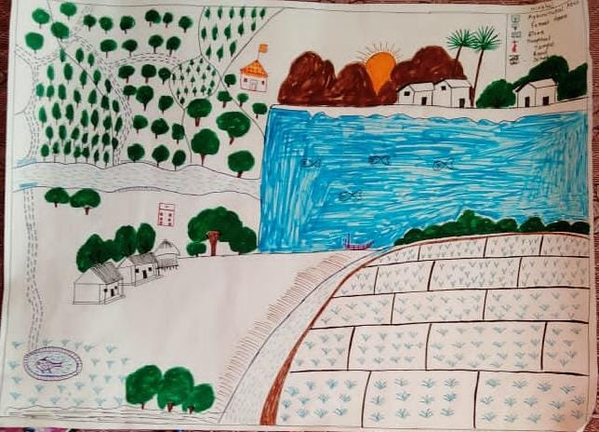
Social & Resource map

Slide 6
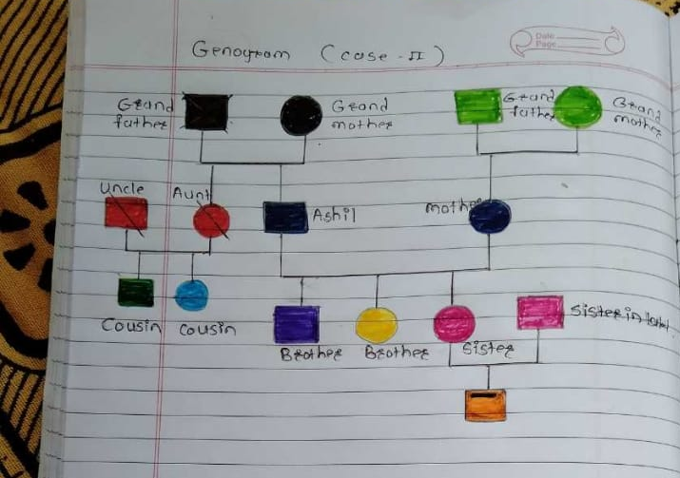
Genogram:
It is graphical representation of family tree

Slide 7
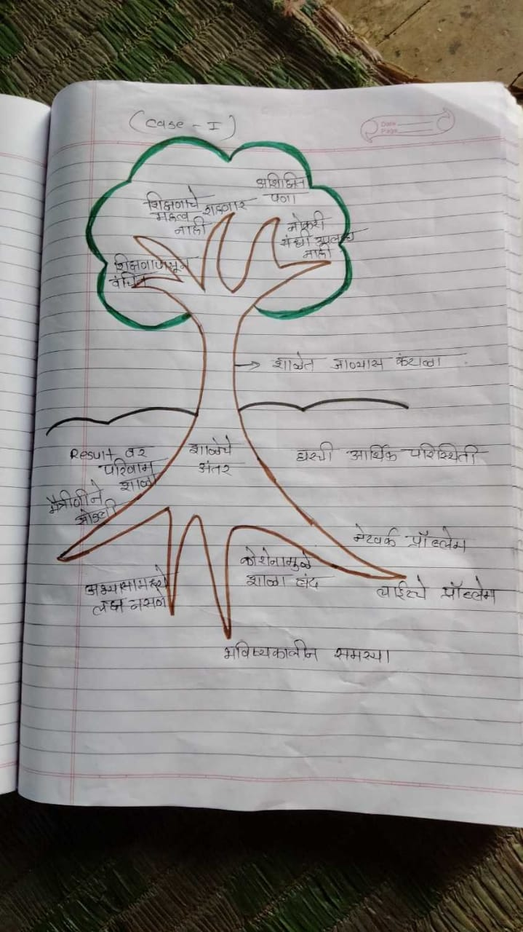
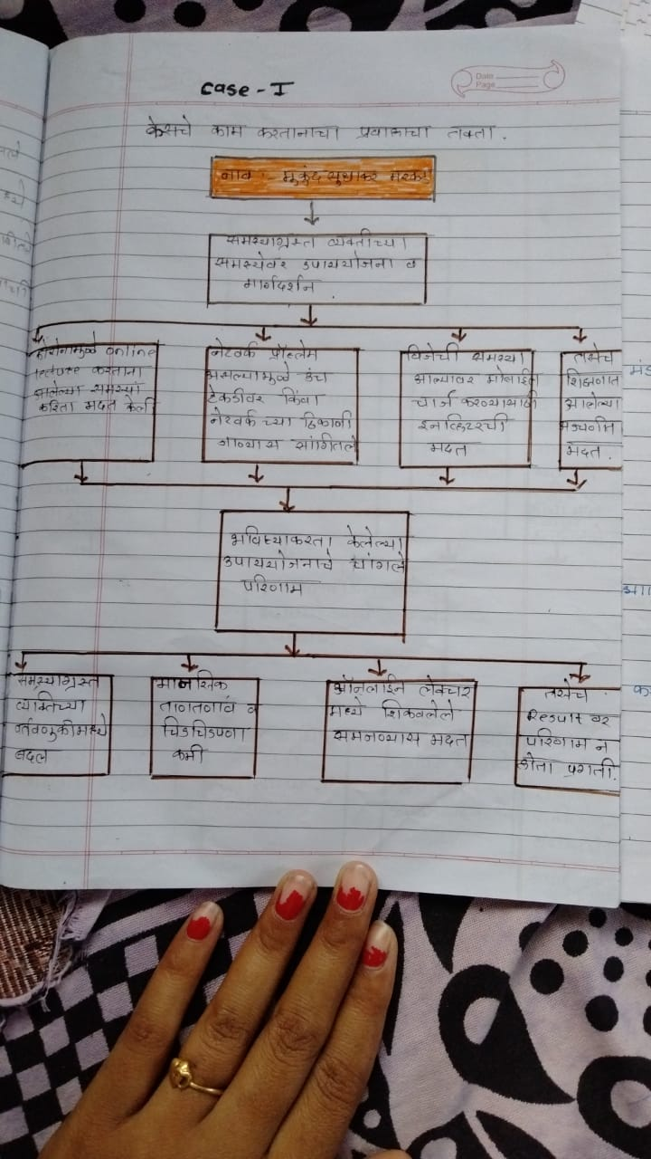
Covid 19 affected peoples case study: 1.Student
Name:Mukund Sudhakar markad
Age:22
Problem tree flow of solution

Slide 8
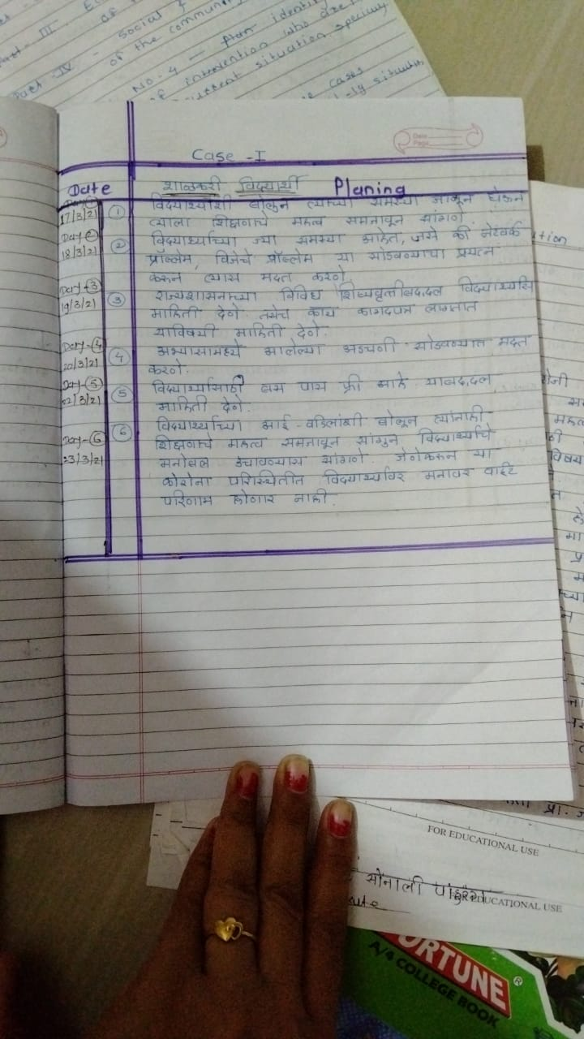
Plan of intervention:

Slide 9
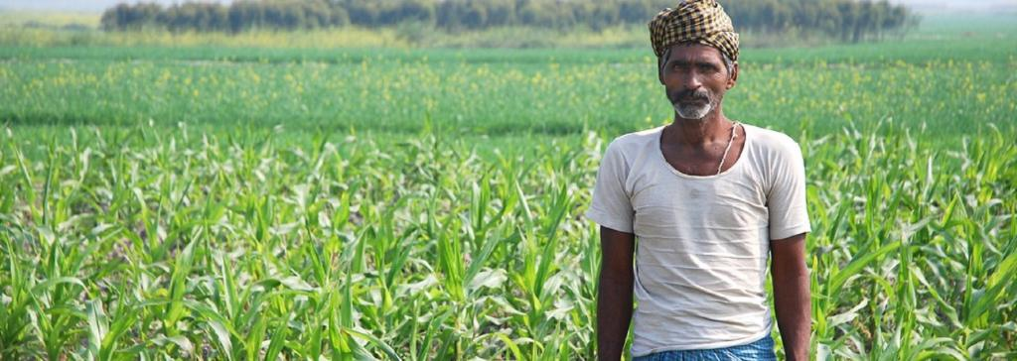
During covid19 affected families:
Family 1:
Name:Navnath tatyaba pakhare
Total member :05
Total male:02
Total female:02
Total income:15000
During covid 19 income:10000
Occupation: farming
Village:Madhi
Family 2:
Name:Santosh raosaheb misal
Total member :07
Total male:03
Total female:03
Total income:19000
During covid 19 income:12000
Occupation job
Village:Madhi

Slide 10
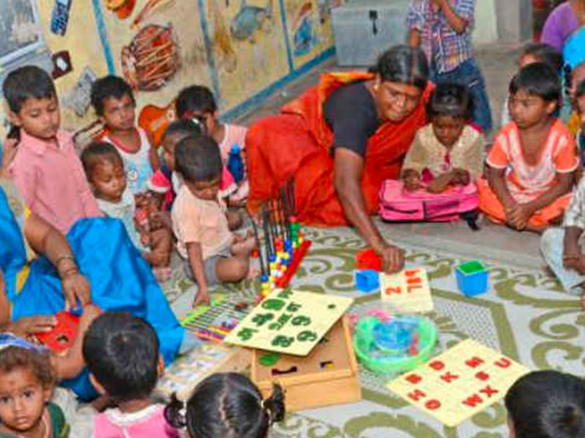
Family 3:
Name:Sadhna machindra kute
Total member :06
Total male:02
Total female:02
Total income:17000
During covid 19 income:13000
Occupation:Aganwadi worker
Village:Madhi

Slide 11


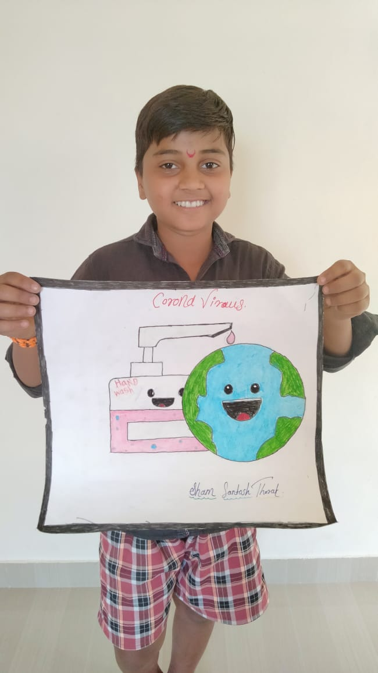
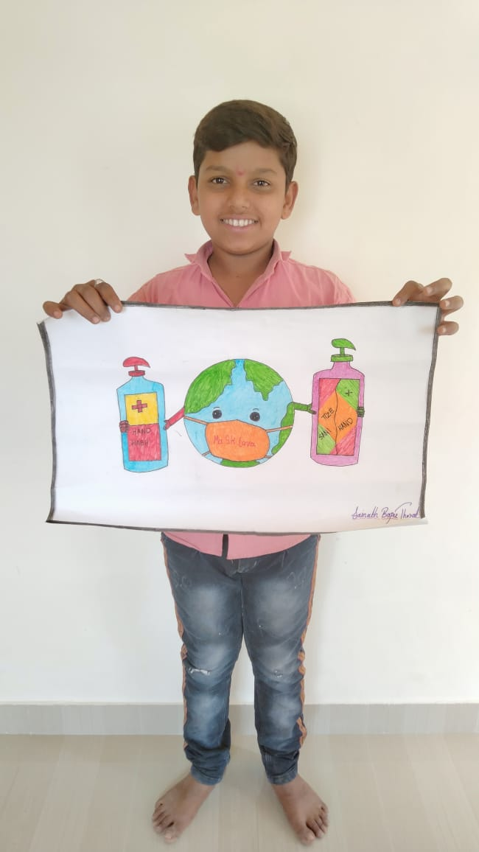
Covid 19 Awareness program

Slide 12
Observation and learning:
Improved communication skill
Analysis and observation skill improved
Improved problem solving skill
Improved personal knowledge
Improved data collection skill

Slide 13
THANK YOU

