Slide 1
Name :- Rajugopal Nikhil Mallik
Roll No:- 90
MSW- 2year, Sem-IV supervisor :- jaimon Varghese sir title :- PREVENTION OF PANDEMIC AND ROLE OF SOCIAL WORK
Name of the NGO :- Shri Amrutvahini Gram Vikas Sanstha, Ahmednagar.
Founder :- Shri Dilip Gunjal Sir
Director :- Mr.Siraj Sheikh
Amrutdeep Project : Beginning 2013
(Current Project Manager :- Shubhangi Mane)
Creating awareness about HIV among migrant workers.

Slide 2
Health Cheak up Camp
1. health check up camp taken: 6
2. people visited during camp: 300
3. people taken vaccination: 40

Slide 3
CONSTRUCTION AREA VISIT. A’NAGAR we visited 7 sites i get response from 4 sites

Slide 4
HIV & CORONA POSTERS MAKING
1. hiv posters people : 3
2. corona posters people: 2

Slide 5
HOME VISIT COVID-19 EFFECT ON FAMILY NAGAPUR,GAUTAM NAGAR.
1. family visit : 4
2.people taken vaccination : 6
3.provide gov. scheme for : 1

Slide 6
Vaccination of Psychotics in Manavseva Project.
1. 32 people get vaccine out of 40 people.

Slide 7
‘HIV’ Testing’ at a’nagar
1. total registration : 150
2.hiv testing : 75

Slide 8
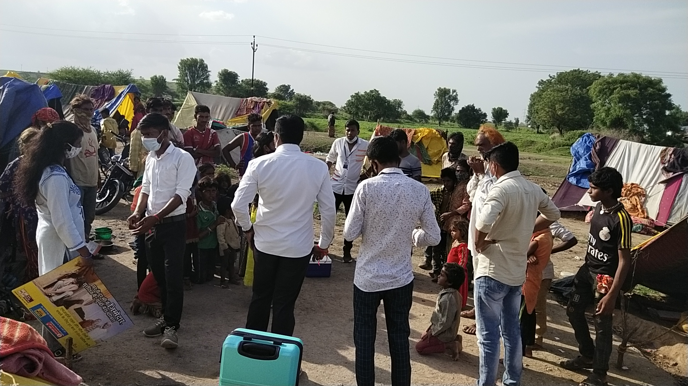
Awareness of ‘Covid 19’ & ‘HIV’ & ‘Street Play’
1. meet 60 people
2. testing 15 people

Slide 9
२. Observation :- observation first of all, we look what is done in the agency and how many staff there are. The work in the office was going very smoothly, a very systematic manner. There were difficulties in encouraging people to be vaccinated, there were difficulties in coordinating the work of the safe project and the organization, and there were observations on how HIV testing is done, as well as how to talk to people working in construction. The impact of corona on society was observed. Corona lost the head of the family, as well as what kind of problems the family had.

Slide 10
२. Learning:-
1. Counseling
2. problem solving skill
3. group work
4. social action
5. modeling
6. five components
7. problems identity skills

Slide 11
3.Challenges :-
1) There was difficulty in encouraging people to get vaccinated.
2) Difficulty in coordinating the work of safe project and organization
3) Difficulty in using some methods of social work
4) Difficulty in connecting resources and mobilizing financial resources
5) Difficulty in networking with various organizations

Slide 12
Thank you

