Slide 1
Relationship between Social Sciences and Psychiatry
MPSW 3
Psychiatric Information in Child and Adult Psychiatry
Unit 1.2

Slide 2
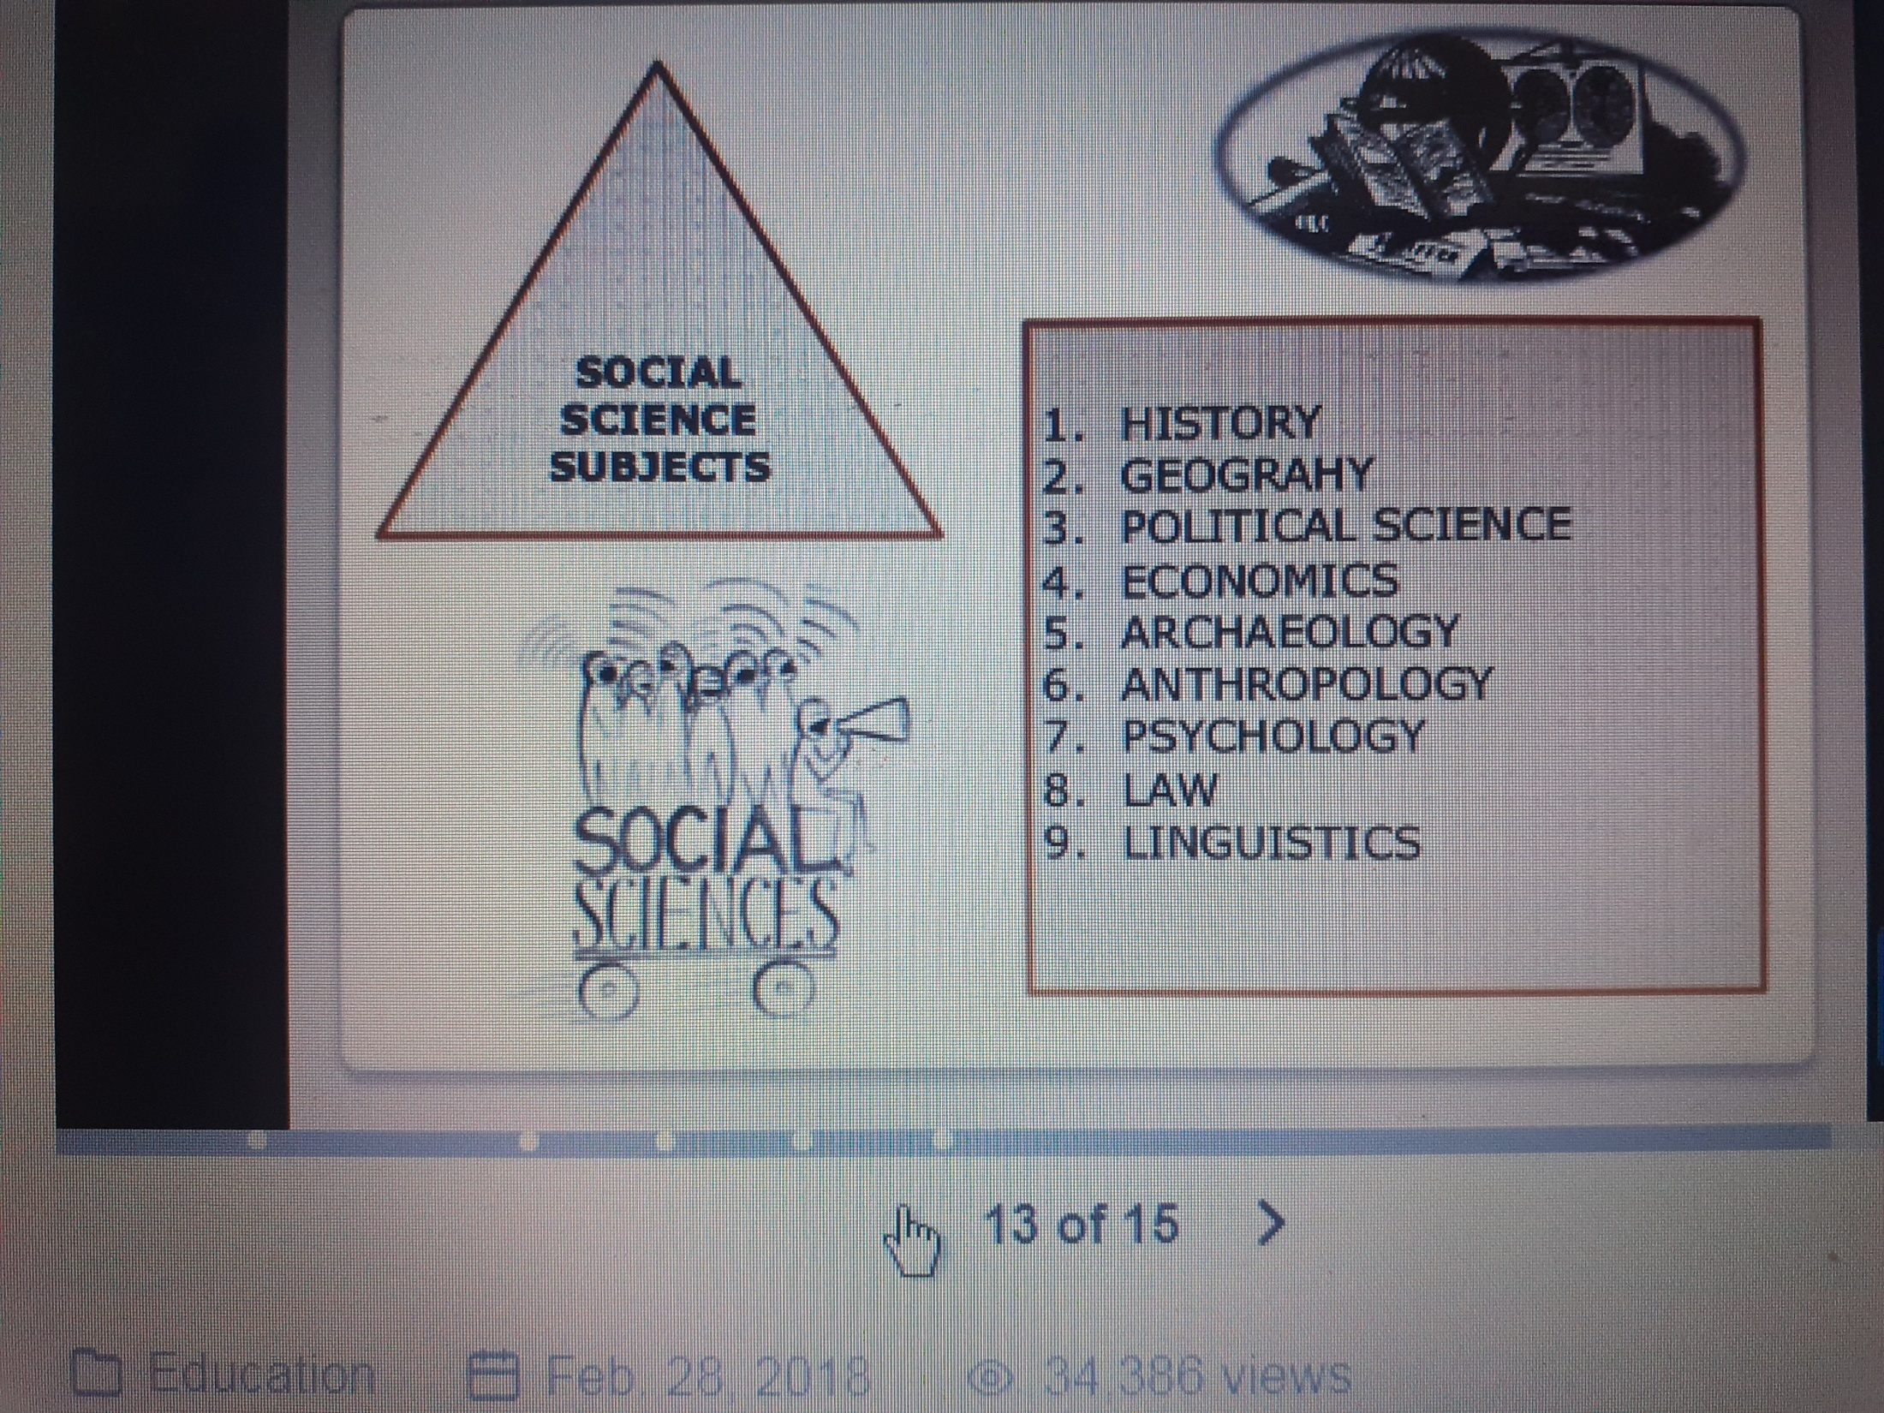
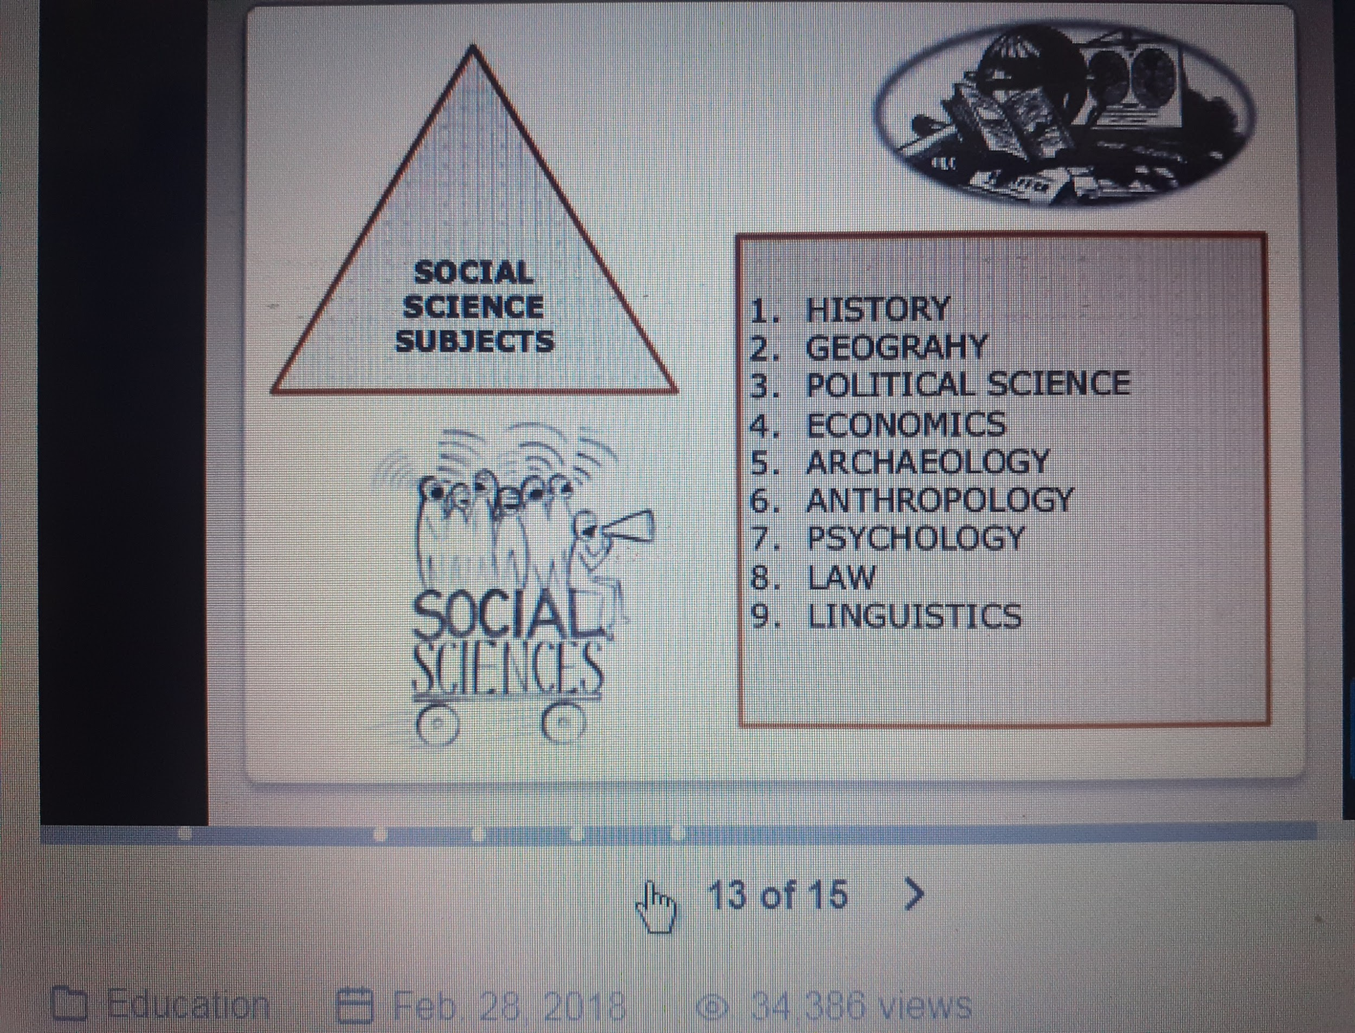

Slide 3
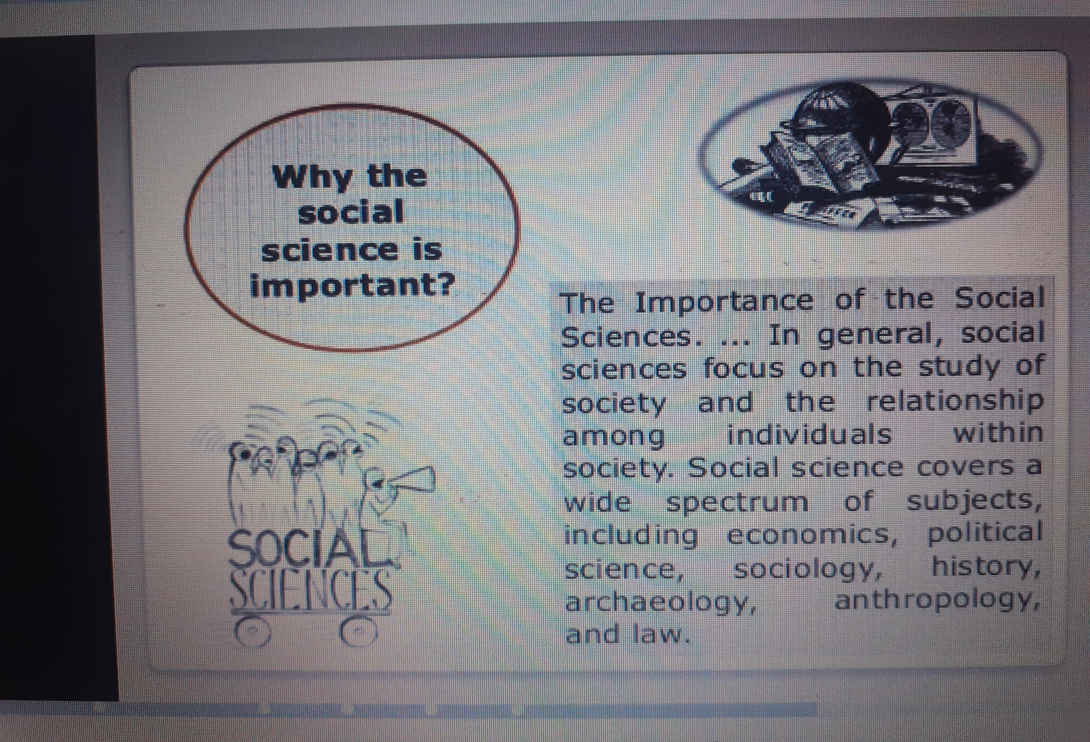

Slide 4
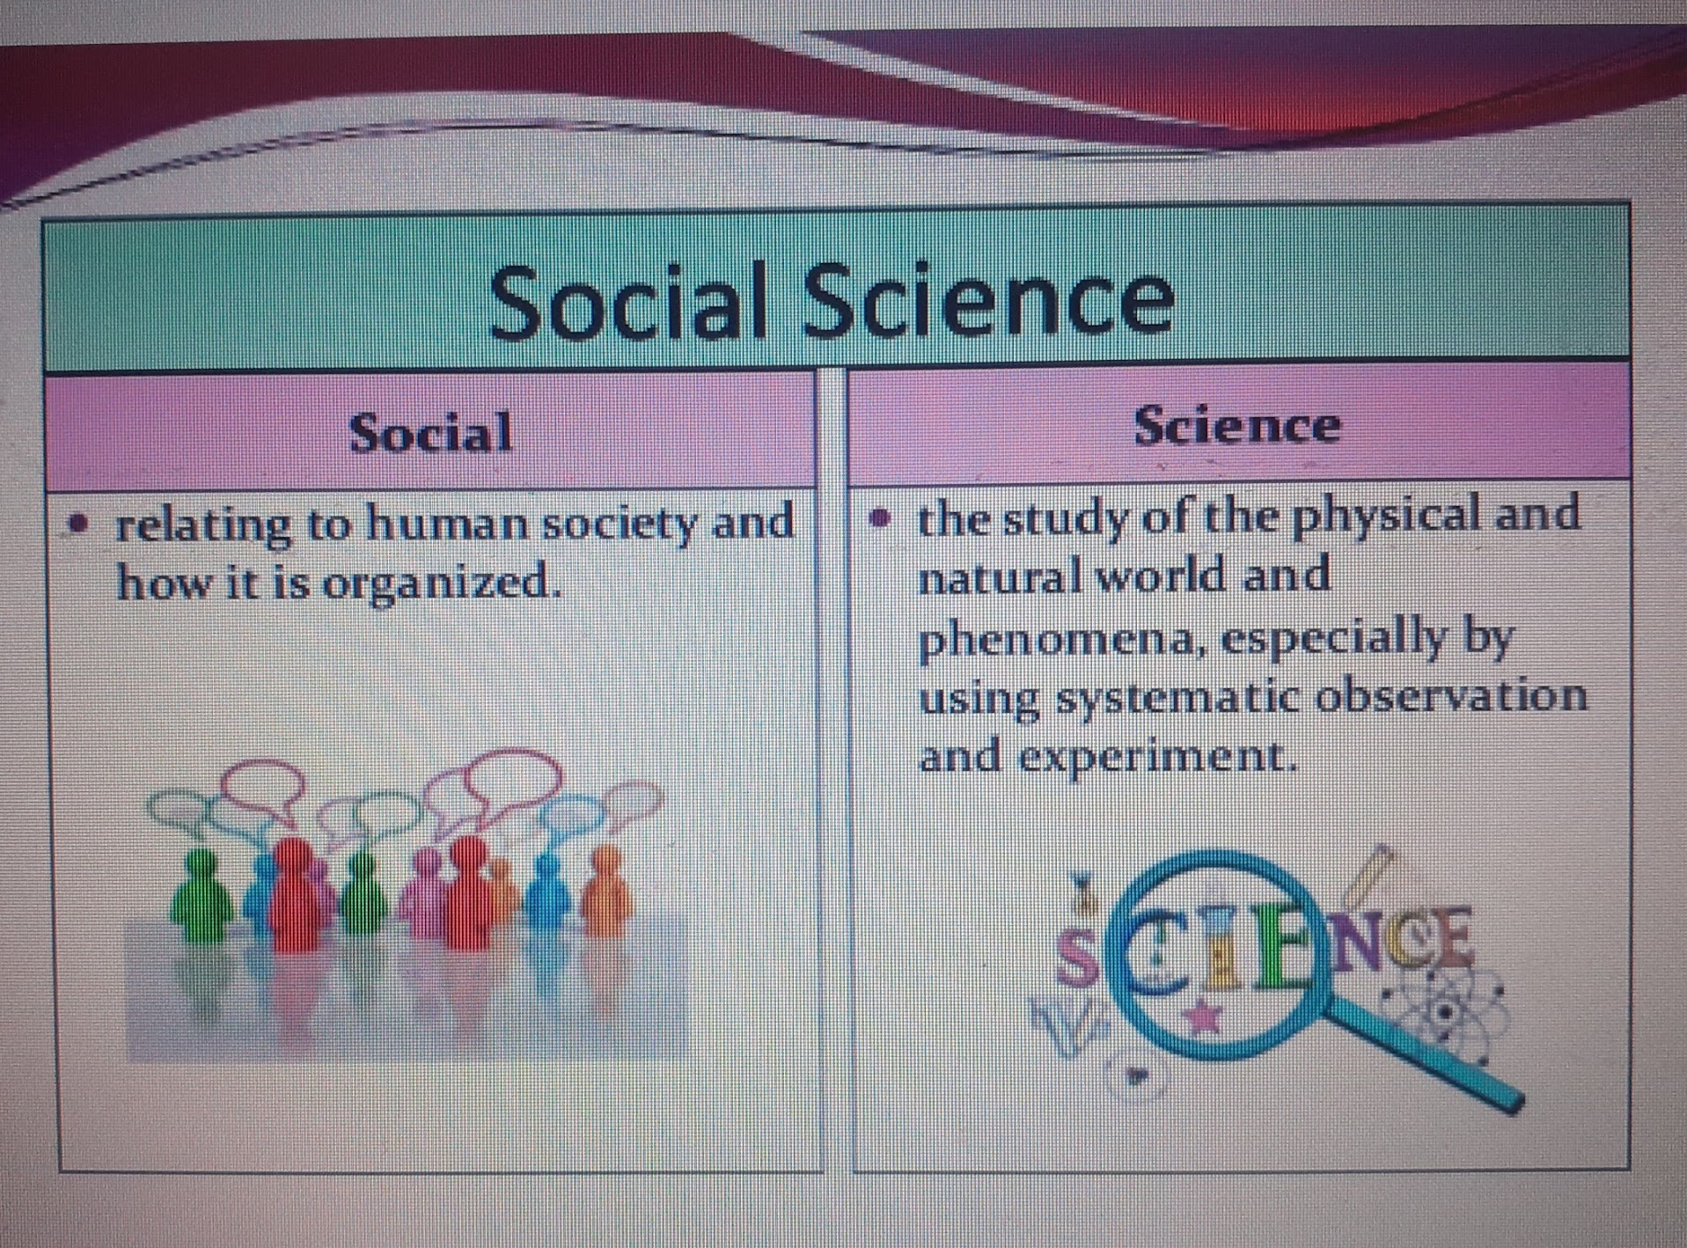

Slide 5
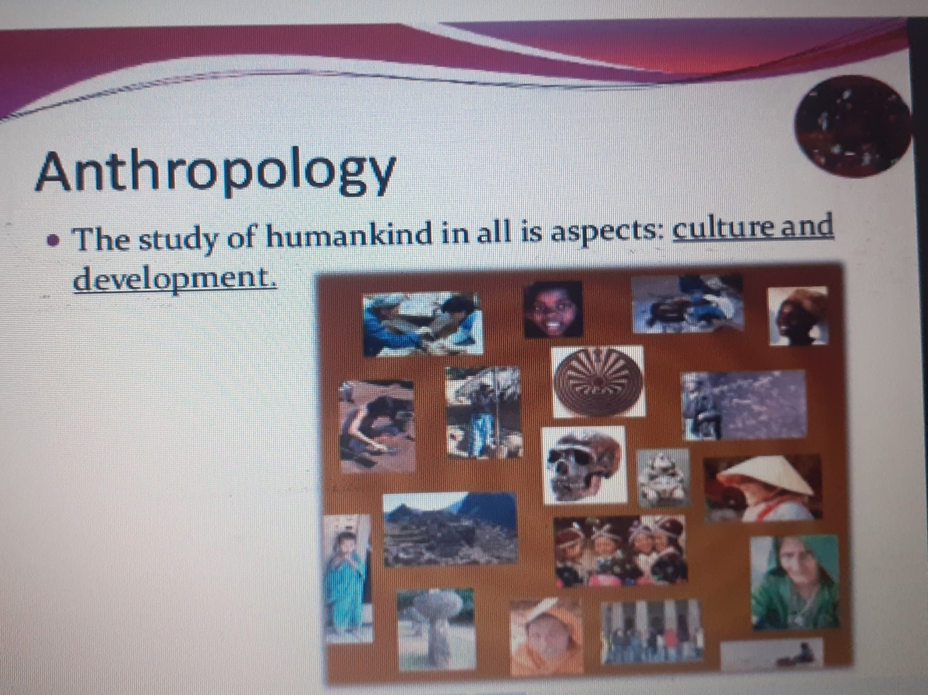

Slide 6
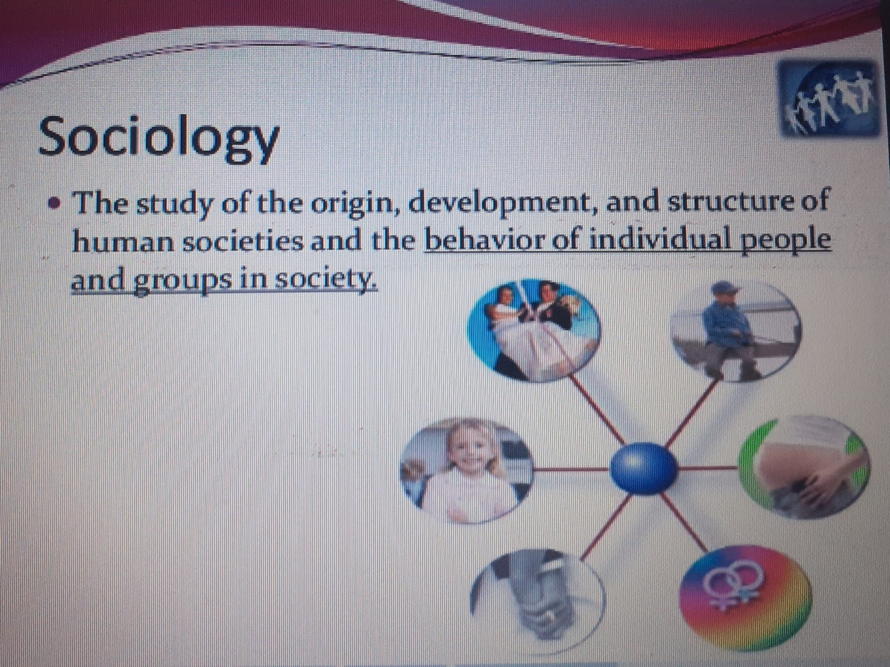

Slide 7
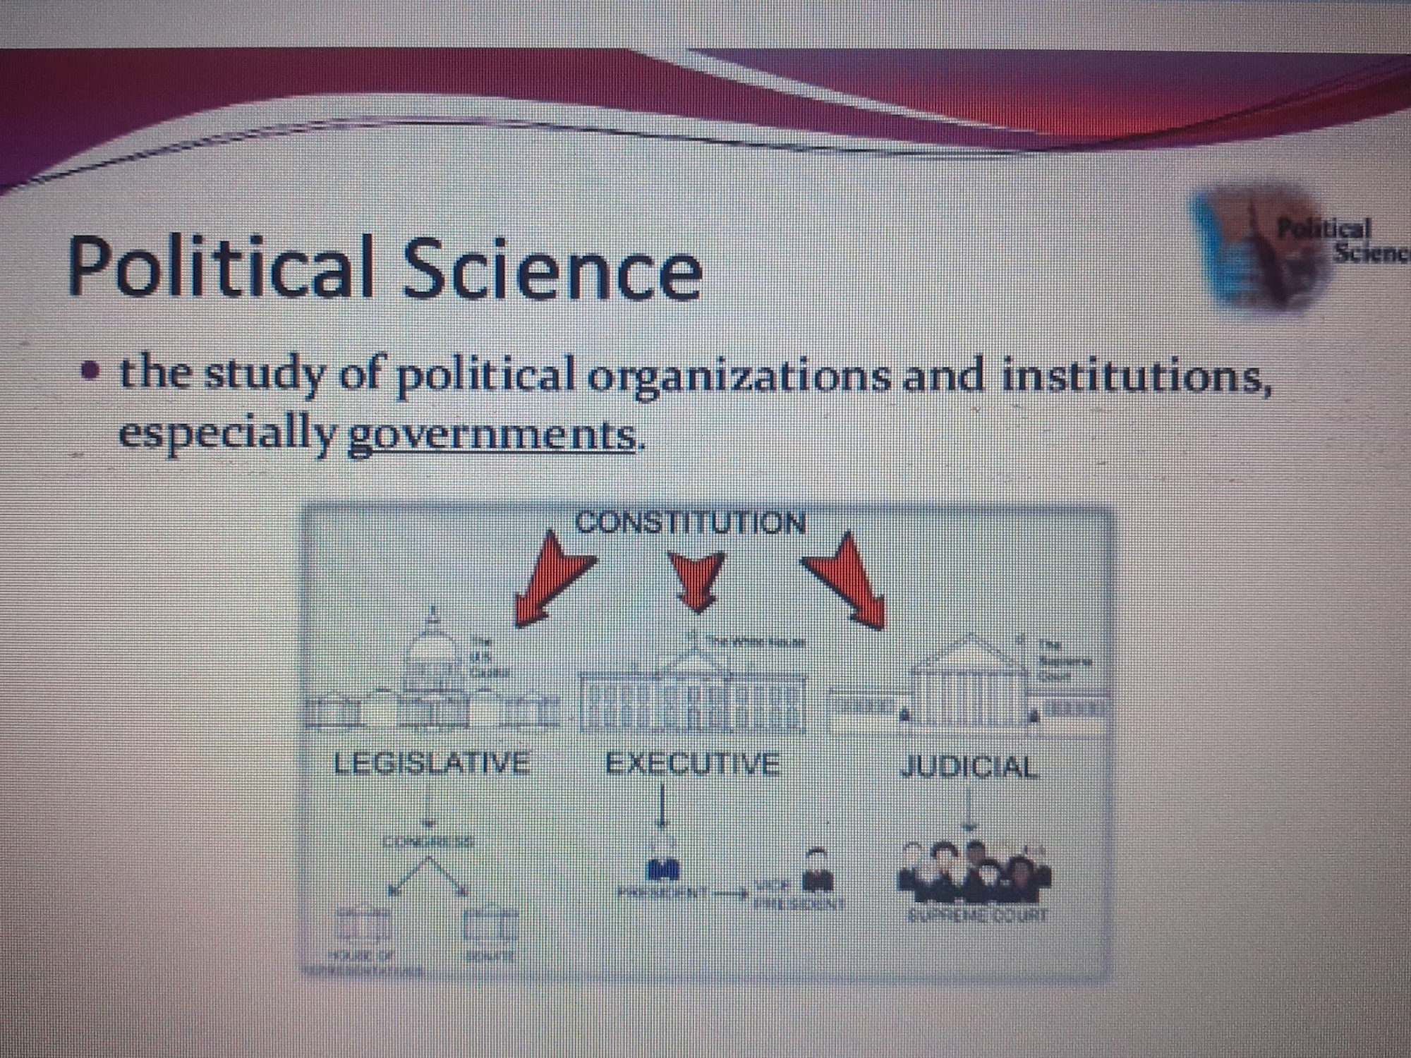

Slide 8
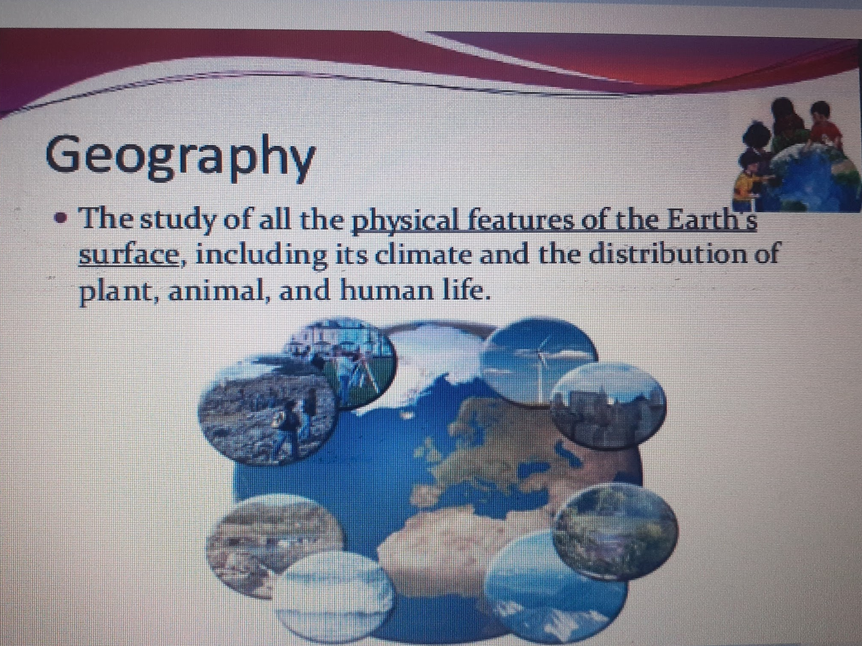

Slide 9
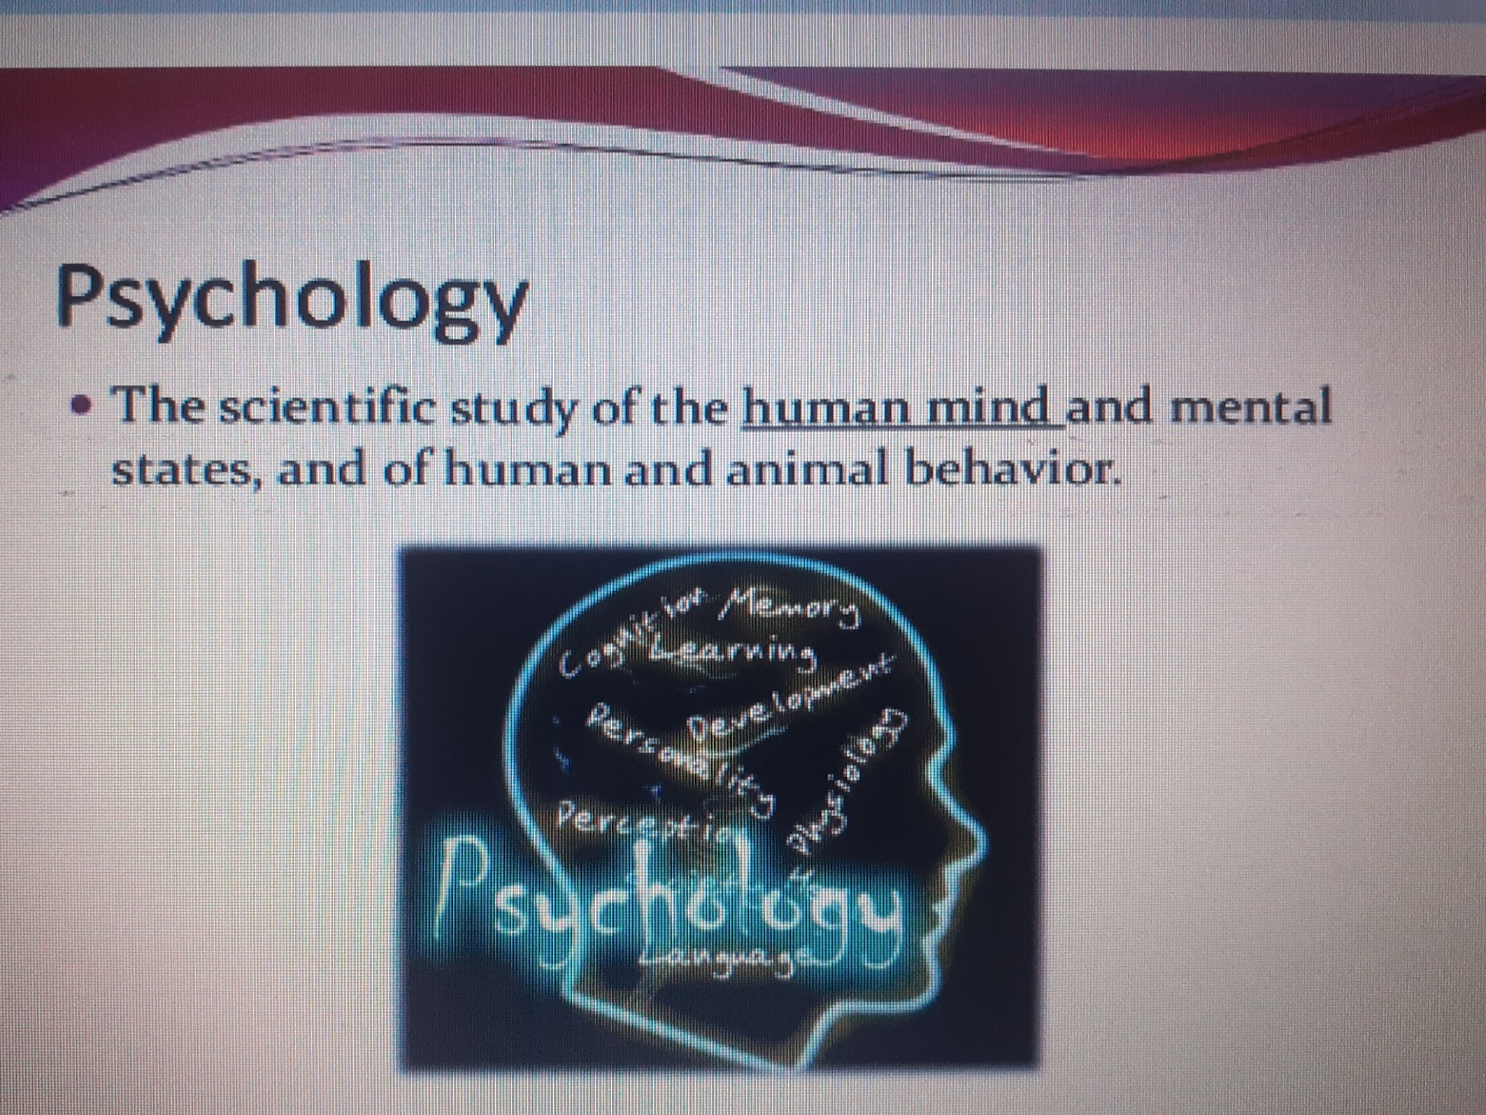

Slide 10
Psychiatry is a branch of medicine that deals with treatment of behavioural disorders

