Slide 1
Team Assessment in
Psychiatry

Slide 2
INTRODUCTION
Four health care professionals constitute the core mental health disciplines :
  psychiatric nurse,
  psychiatrist,
  clinical psychologist and
  psychiatric social worker

Slide 3
Teamwork means the combined, co-coordinated & dedicated effort of each & every member of the team toward achievement of the vested interest, target or goal of the team as an entity.

Slide 4
Teamwork is vital for the assessment, diagnosis, treatment, in-patient rehabilitation as well as community based rehabilitation of the mentally ill patient.

Slide 5
CONCEPT OF MULTI-DISCIPLINARY TEAM
Multi-disciplinary team functions as an Inter-disciplinary team where the total care of the patient requires not only the total input of each member of this team but also the inter-disciplinary coordinated effort .
Team work leads to “Holistic Patient Care” of the individual, his family & the community at large

Slide 6
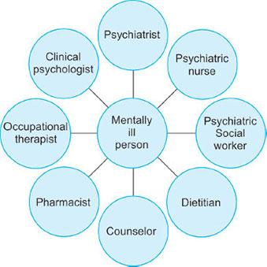

Slide 7
PSYCHIATRIST –
a doctor with post-graduation in psychiatry with residential training.
responsible for diagnosis, treatment & prevention of mental disorders
prescribes medicines & somatic therapy
functions as a leader of the mental health team.

Slide 8
2. PSYCHIATRIC NURSE CLINICAL SPECIALIST
Psychiatric nurse clinical specialist with a master degree in nursing, preferably with post–graduate research work.
participates actively in primary, secondary & tertiary prevention of mental disorder & provides individual, group & family psychotherapy in a hospital & community setting.

Slide 9
takes up the responsibility of teaching, administration & research, bedsides publishing work in a mental health setting.
takes up the role of a leader & can practice independently.

Slide 10
3. REGISTERED NURSE IN A PSYCHIATRIC UNIT
registered general nurse or B Sc nurse with a diploma in psychiatric nursing
skilled in caring for the mentally ill,
gives holistic care by assessing the patient’s mental, social, physical, psychological & spiritual needs, making a nursing diagnosis, formulating, evaluating & rendering the appropriate nursing care.

Slide 11
co-ordinates with the clinical nurse specialist in a community mental health setting.
updates knowledge via continuing education, in- service education, workshops & courses conducted by open Universities.

Slide 12
4. CLINICAL PSYCHOLOGIST
Clinical psychologist holds a doctoral degree in clinical psychology & is registered with the clinical psychologist’s association.
conducts psychological, diagnosis tests, interprets & evaluates the finding of these tests & implements a program of behavior modification.

Slide 13
5. PSYCHIATRIC SOCIAL WORKER
a graduate in social work & post-graduate in psychiatric social work.
assesses the individual, the family & community support system, helps in discharge planning, counseling for job placement & is aware of the state laws & legal rights of the patient & protects these rights.
skilled in interview techniques & group dynamics.

Slide 14
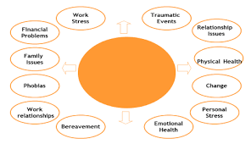
              Counselling

Slide 15
Dietician
Diet and Psychological element: The relationship between our dietary-nutrient intake patterns and our psychological moods, emotions and affect (e.g., resilience, flourishing, creativity, negativity).
Diet and Behavioural element: The behaviours, reactions, and choices in which we engage that result from thoughts and emotions influenced by our dietary intake and food environment (e.g., increased reactive behaviour or changed dietary behaviour patterns)

Slide 16
Diet and Perceptual element: Our interpretation of food-related information stemming from our society, familial, and cultural dietary environment (what foods we are exposed to and how that influences our choices).
Diet and Interceptive element: The internal physiological sensations we experience in response to our dietary intake patterns (discomfort, pain, energy, fatigue, craving and wanting).

Slide 17
Diet and Cognitive element: The relationship between dietary-nutrient intake and our cognitive functions and capacity, including memory, attention, learning and appetite control.
Diet and Psychosocial element: Examining the role that family, culture, community, society, and socioeconomic status play in relationship to our dietary-nutrient intake patterns.

Slide 18
6. PSYCHIATRIC PARA-PROFESSIONALS
Psychiatric Nursing Aids/Attendants
ECT technicians
Auxiliary Personnel
Occupational Therapist
Recreational Therapist
Diversional Play Therapist
Creative Art Therapist
Clergyman

Slide 19
A. Psychiatric Nursing Aids/Attendants: They have high school training & are trained on the job. They aid maintaining the therapeutic environment & provide care under supervision.
B. ECT technicians: They undergo training for 6-9 months. Their function is to keep ready the ECT under the supervision of a psychiatrist or anesthetist.

Slide 20
C. Auxiliary Personnel: They are volunteer housekeeper or clerical staff & require in-service education to interact with the patient therapeutically.
D. Occupational Therapist: creative techniques to assess the interpersonal responses of the patient. Patients are helped to develop skill in the area of their choice & become economically independent. They are helped to work in sheltered workshop.

Slide 21
E. Recreational Therapist: The recreational therapist plans activities to stimulate the patient’s muscle co-ordination, interpersonal relationship & socialization. These approaches are need-based.
F. Diversional Play Therapist: Makes observation of a child / patient during his play, the type of toys & his reaction toward the doll, beating, calling or throwing, explores the behaviour of the child & relates to conditions like phobia, child abuse, separation or any other condition.

Slide 22
G. Creative Art Therapist: an art graduate & encourages the patient to express his work freely with colours & analysis the use of various colours, drawing of various scenes etc., helps in diagnosis & also in bringing the repressed feelings of the patient to the conscious level.
H. Priest: religious persons come to the hospital unit once a week (depending on the patient’s religious faith) & have a spiritual talk with the patient.

