Slide 1
MENTAL RETARDATION

Slide 2
DEFINITION
“Mental retardation refers to significantly subaverage general intellectual functioning resulting in or associated with concurrent impairments in adaptive behavior & manifested during the developmental period”
It has historically been defined as an Intelligence Quotient score under 70

Slide 3
Prevalence
About 3% of the world population is estimated to be mentally retarded.
In India, 5 out of 1000 children are mentally retarded
Mental retardation is more common in boys than girls.
With severe & profound mental retardation mortality is high due to associated physical disease.

Slide 4
INTELLIGENCE QUOTIENT (IQ)
An intelligence quotient, or IQ, is a score derived from one of several different standardized tests designed to assess intelligence.
Grades of IQ
Under 70 Definite feeble mindedness
70 to 79 Borderline deficiency
80 to 89 Dull
90 to 109 Normal or average intelligence
110 to 119 Superior intelligence
120 to 140 Very superior intelligence
140 + Genius

Slide 5
The Classical definition comprises 3 components :
  1- subaverage intellectual function
  2- that result from an injury, disease or abnormality before the age of 18 years
  3- resulting in impaired ability to adapt to the environment.

Slide 6
IQ classification:
(Average I.Q is 100; normal ranges from 90 to 110)
1-Border line { IQ 70-80 }
2-Mild MR { IQ 50-70 }
3-Moderate MR{ IQ 35-49 }
4-Severe MR { IQ 20-34 }
5-Profound MR { IQ below 20 }

Slide 7
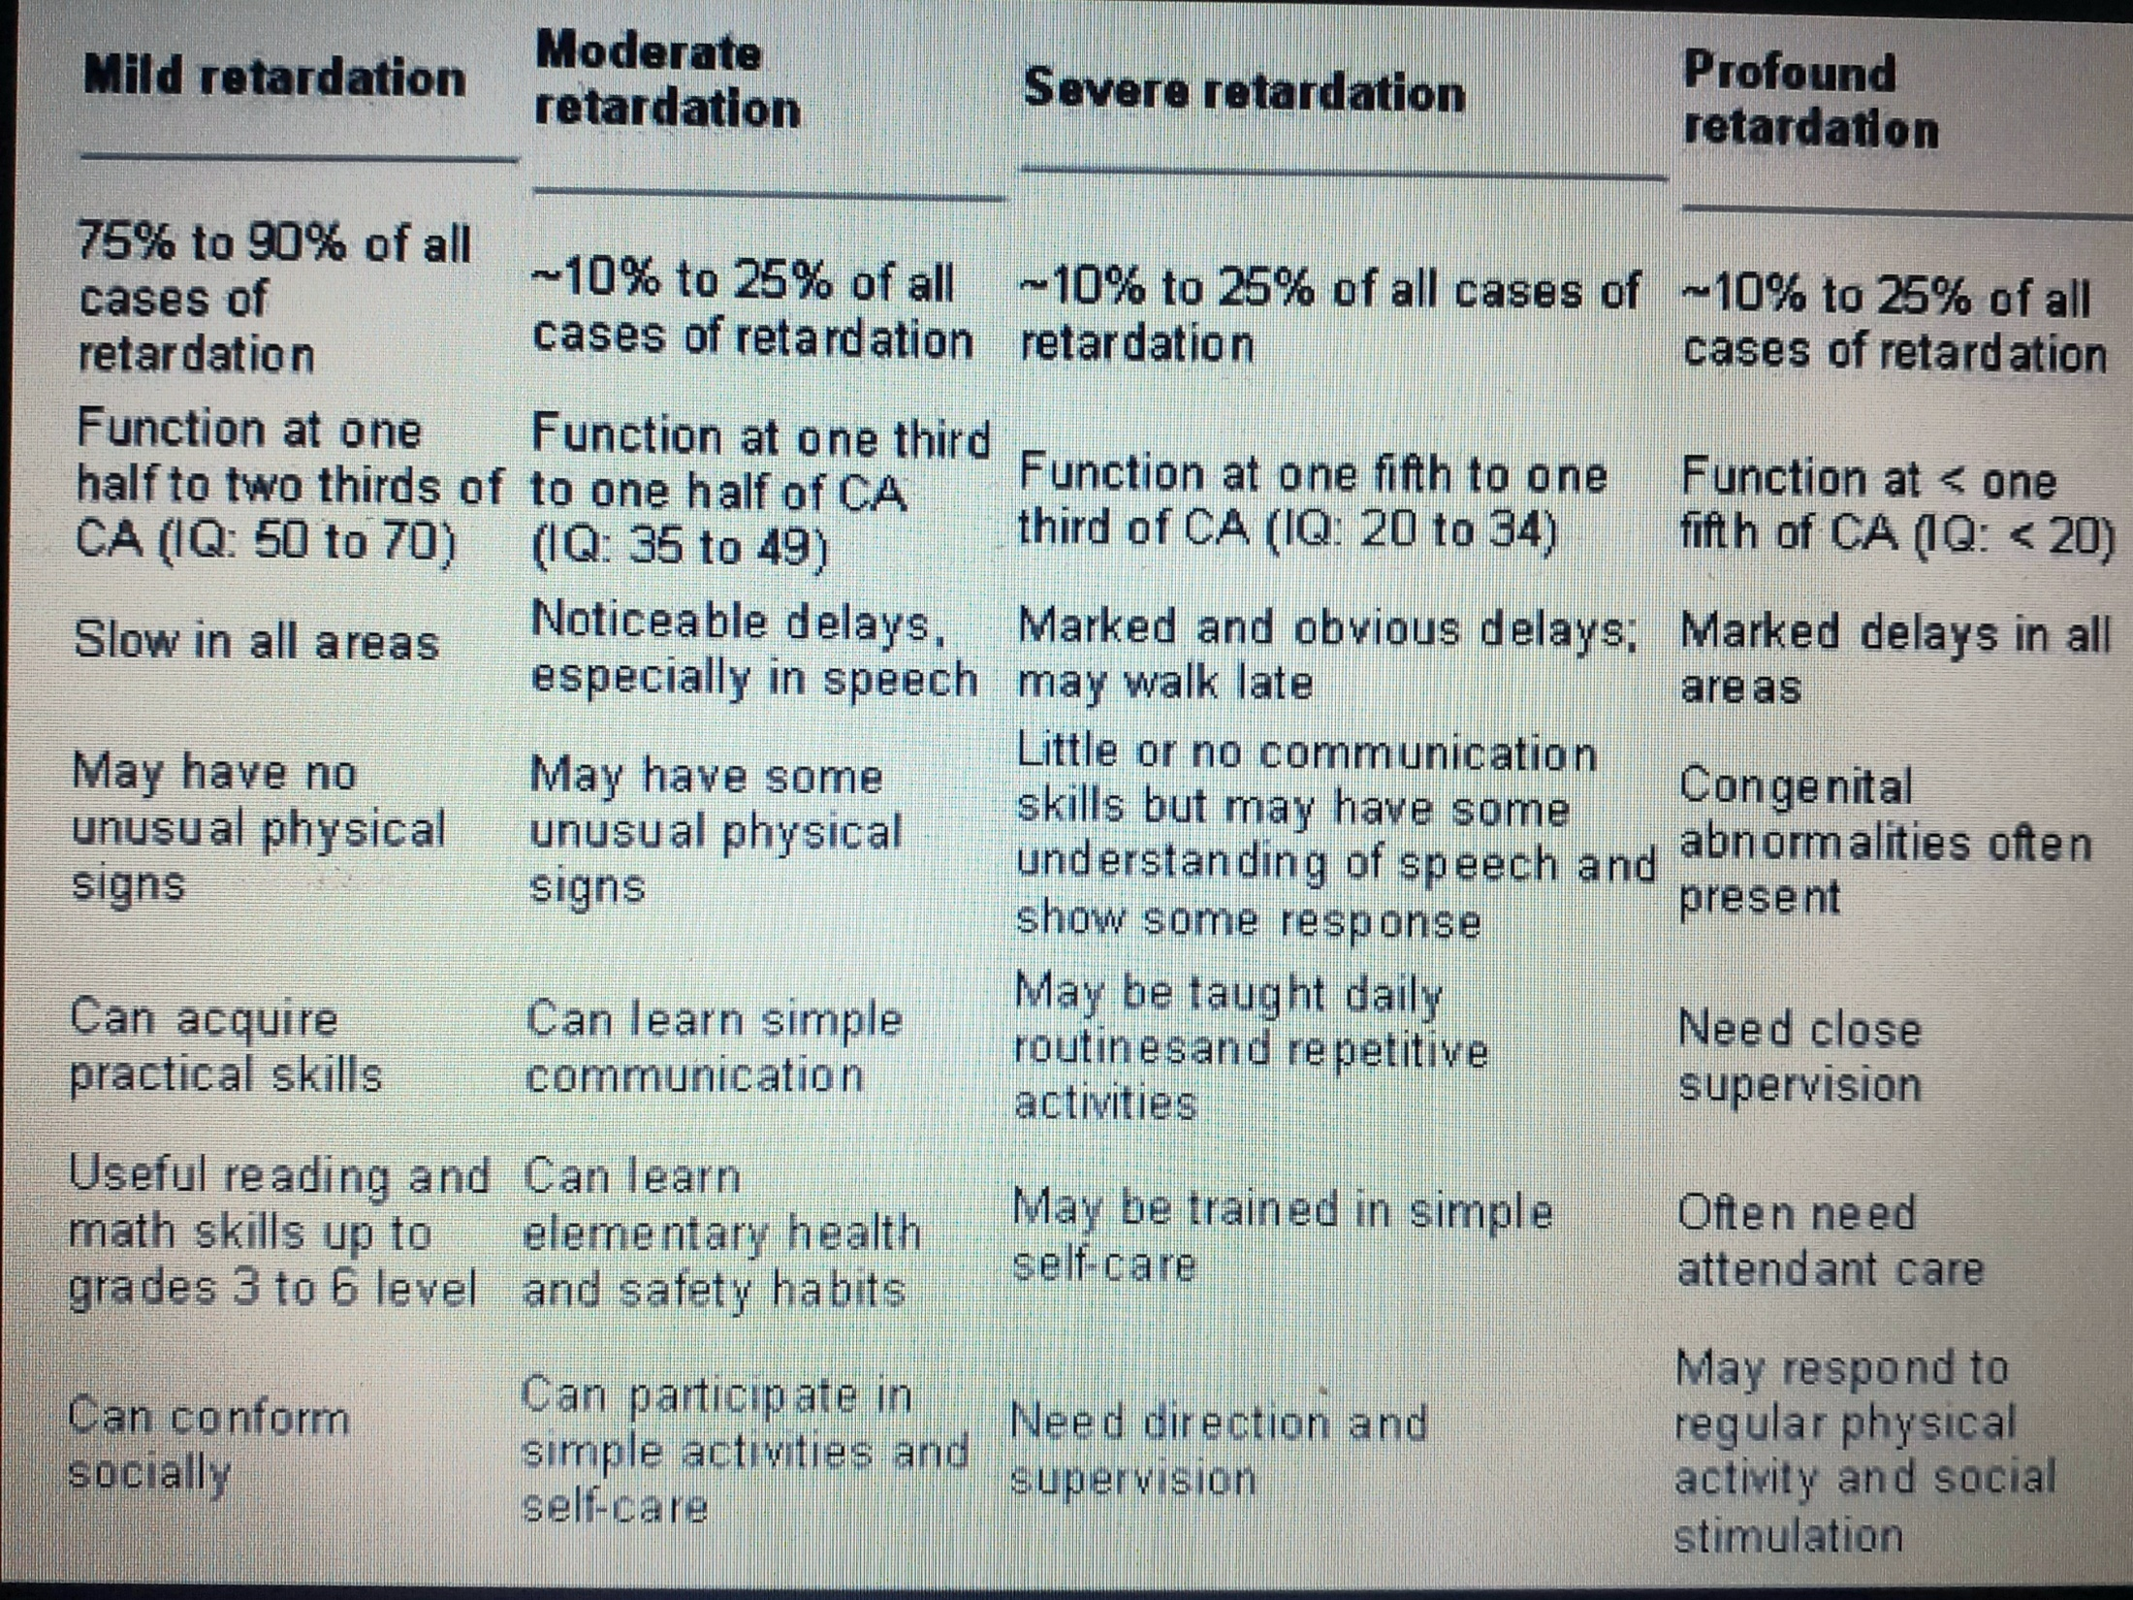

Slide 8
ETIOLOGY
Environment: 5-20%
Acquired medical condition (trauma, infection, etc.): 5%
Prematurity, IUGR (Intrauterine growth restriction): 10 %
Early embryonic (prenatal):30%
Genetic: 5%
Unknown: 30-40 %

Slide 9
ETIOLOGY CLASSIFICATION
Prenatal (before birth)
Perinatal (during and immediately after childbirth)
Postnatal (after birth)

Slide 10
PRENATAL
Chromosomal disorders | Single gene disorders | Adverse material / environmental influences
Downs syndrome, | Inborn errors of metabolism, such as galactosemia. | Deficiencies , such as iodine deficiency and folic acid deficiency
Fragile X syndrome, | Brain malformations such as genetic microcephaly, hydrocephalus | Using substances such as alcohol Exposure to other harmful chemicals such as pollutants, heavy metals, harmful medications Infections
Klinefelters syndrome (male with extra x chromosome 47,XXY)

Slide 11
PRENATAL CAUSES
Genetic Disorders
Fragile X syndrome FXS - Fragile X syndrome is a genetic condition that causes a range of developmental problems including learning disabilities and cognitive impairment.
Klinefelter syndrome - male with extra x chromosome 47,XXY
Down syndrome
Metabolic disorders - Galactosemia
Skin disorders - neurofibromatosis and Tuberculosis
Endocrine – hypothyroidism

Slide 12
Cranial Malformations
Hydrocephaly - a condition in which fluid accumulates in the brain, typically in young children, enlarging the head and sometimes causing brain damage.
microcephaly - abnormal smallness of the head, a congenital condition associated with incomplete brain development.
Anencephaly - a severe congenital condition in which a large part of the skull is absent along with the cerebral hemispheres of the brain.

Slide 13
Congenital Factors
Maternal : Rubella, Syphilis
Toxins : drugs, fetal alcohol syndrome

Slide 14
Perinatal Causes
Low Birth weight: premature, teen pregnancy, poor nutrition .. 21 % MR
Birth Anoxia: A breech birth is when a baby is born bottom first instead of head first, as is normal (3–5% of pregnancies), knotted umbilical cord.

Slide 15
Natal
Third trimester ( late pregnancy) | Labour (during delivery) | Neonatal (first four weeks of life)
Complications of pregnancy Diseases in mother such as heart and kidney disease and diabetes, Placental dysfunction | Severe prematurity, very low birth weight, birth asphyxia; Difficult and/or complicated delivery, Birth trauma | Septicemia, severe jaundice, hypoglycemia (deficiency of glucose in the blood stream)

Slide 16
POSTNATAL CAUSES
Child abuse and neglect
Traumatic brain injury
Infection - meningitis and encephalitis
Nutritional deficiencies
Cultural and familial

Slide 17
POSTNATAL (IN INFANCY AND CHILDHOOD)
Brain infections such as tuberculosis, Japanese encephalitis, and bacterial meningitis
Head injury
Chronic lead exposure
Severe and prolonged malnutrition
Gross under-stimulation (cultural / familial)

Slide 18
COMMON FEATURES
Delays in oral language development
Deficits in memory skills
Difficulty learning social rules
Difficulty with problem solving skills
Delays in the development of adaptive behaviors such as self-help or self-care skills.

Slide 19
DIAGNOSIS
Three criteria
an IQ below 70
significant limitations in two or more areas of adaptive behavior (as measured by an adaptive behavior rating scale, i.e. communication, self-help skills, interpersonal skills, and more)
evidence that the limitations became apparent before the age of 18

Slide 20
HISTORY - COMPLETE AND DETAILED
surgical history - trauma , accident
medical illnesses - hospitalization,
pregnancy history - maternal age, infections.
birth - type , weight, complications
Postnatal - incubator, ventilator, disease
drugs: mother and child
developmental: mile stones, speech
Educational: schooling, IQ tests
behavioral: skills, attention, activity
family: consanguinity, inherited
social:

Slide 21
INVESTIGATIONS
Electrophysiology : EEG , auditory, visual evoked potentials
Psychological Assessment:
Imaging : brain MRI , CT , skeleton films
Metabolic labs: plasma, urine organic
DNA analysis: chromosomes

Slide 22
MANAGEMENT
Management of mental retardation (MR) begins with breaking the news to parents of affected children sensitively, compassionately, and culturally appropriately

Slide 23
TREATMENT
Early intervention is critical
Optimal time: Preschool years
Encourage exploration
Teach basic skills
Celebrate achievements
Rehearsal, rehearsal, rehearsal
Protection from teasing/social rejection

Slide 24
General rules:
Identify the cause then initiate a comprehensive plan
Special school programs
Community services
Special educators, language therapists, behavioral therapists, occupational therapists, and community services that provide social support and respite care for families affected by MR.

Slide 25
PREVENTION
Prenatal screening for genetic defects and genetic counseling for families at risk for known inherited disorders can decrease the risk of inherited mental retardation.
Government nutrition programs are available to poor children can reduce retardation associated with malnutrition

Slide 26
Increased public awareness of the risks of alcohol and drugs during pregnancy
Environmental programs to reduce exposure to lead, mercury, and other toxins
Infectious
The prevention of congenital rubella syndrome

