Slide 1
Unit 3 Group process and group dynamics
3.3. Group dynamics - Group bond, Sub groups, Decision making, Isolation, Leadership, Conflict
Dr. Jaimon Varghese

Slide 2
Group dynamics
A group can be characterised as a dynamic whole, that means, a change in the state of any subpart changes the state of any other subpart (Kurt Lewin, 1948:84)

Slide 3
Group dynamics
(Ronald W Toseland and Robert F Rivas, 1984:56-57)
A system is made up of elements and their interactions.
Task and treatment groups as social systems can be defined as people and their interactions, that are referred to as group process.
The group process generates unique forces that influence group members as the group as whole.

Slide 4
Group dynamics
(Ronald W Toseland and Robert F Rivas, 1984:56-57)
The forces generated by the group process are often referred to as group dynamics.
Group dynamics refer to the properties that result from the group process, such as norms, roles and status hierarchies.

Slide 5
Strategies for promoting helpful Group dynamics
(Ronald W Toseland and Robert F Rivas, 2012:67-94)
Identify group dynamics as they emerge during the ongoing group interaction
Assess the impact of group dynamics on group members and the group as a whole
Assess the impact of current group dynamics on future group functioning

Slide 6
Examine the impact of group dynamics on members from different racial / ethnic and socio economic backgrounds
Facilitate and guide the development of group dynamics that lead to members’ satisfaction with their participation and that enable the group to achieve its goals

Slide 7
Four dimensions of group dynamics:
(Ronald W Toseland and Robert F Rivas, 2012:67-94)
(1) Communication and interaction pattern (unit 3.2)
(2) Cohesion (Group bond)
(3) Social integration & influence
(4) Group culture (unit 3.2)

Slide 8
Social integration & influence:
(Ronald W Toseland and Robert F Rivas, 2012:81-82)
Social integration refers to how members fit together, influence each other and are accepted in a group
It builds unanimity about the purposes and goals of the group, helping members to move forward in an orderly & efficient manner.
Norms and roles help social integration of the group

Slide 9
Six elements of group dynamics:
(1) Group bond
(2) Sub groups
(3) Isolation
(4) Conflict
(5) Leadership
(6) Decision making

Slide 10
(1) Group bond (cohesion):
Group cohesion is the result of all forces acting on members to remain in a group (Festinger, 1950)
Cohesion is made up of three components:
(1) member to member attraction and a liking for the group as a whole;
(2) a sense of unity and community so that the group is seen as a single entity; and
(3) a sense of teamwork and spirit de corps with the group successfully performing as a coordinated unit (Forsyth, 2010).

Slide 11
Reasons for members’ attraction to the group: (Cartwright, 1968)
The need for affiliation, recognition and security
The resources and prestige available through group participation
Expectations of the beneficial and detrimental consequences of the group
The comparison of the group with other group experiences

Slide 12
Principles for practice of cohesion: (Ronald W Toseland and Robert F Rivas, 2012:83)
A high level of open interaction promotes cohesiveness
When members’ needs are met, they want to continue participating
Achieving group goals makes the group more attractive to its members
Noncompetitive intragroup relationships that affirm members’ perceptions and points of view increase group cohesion

Slide 13
Competitive intergroup relationships help to define a group’s identity and purpose, thereby heightening members’ cohesion
A group that is too large can decrease members’ attraction to the group by obstructing their full participation
When members’ expectations are understood and addressed, group cohesion increases
Groups that offer rewards, resources, status or prestige tend to be attractive
Pride in being a member of a group can increase cohesion

Slide 14
(2) Sub groups:
(Ronald W Toseland and Robert F Rivas, 2012:75-76)
Subgroups form naturally from the emotional bonds and interest alliances among subsets of group members
They help make the group attractive, because members look forward to interact with those who are close to them
Worker intervenes if the attraction within the subgroup is found to be greater than the attraction towards group as a whole

Slide 15
Types of Sub groups:
(Ronald W Toseland and Robert F Rivas, 2012:75-76)
Dyad – close group of two
Triad – close group of three
Clique – close group of more than three members
Isolates – no interaction with group
Scapegoats – receives negative attentions and criticism from group

Slide 16
Committees or delegate council: when the group is too large, subcommittees are intentionally formed to accomplish specific tasks
Challenges of subgroup formation:
Sometimes subgroups challenge the worker or leader
They may substitute their own goals and methods in place of group goals
They may communicate among themselves & fail to listen to other members

Slide 17
Strategies to manage subgroups:
Examine whether the group as a whole is sufficiently attractive
Promote norms on members’ listening to & respecting each other
Promote norms restricting communication to one member at a time
Change seating arrangements

Slide 18
Ask for certain members to interact more frequently with other members
Use programme materials and exercises that separate (break) subgroups
Assign tasks to do in groups composed of members different from their subgroups

Slide 19
(3) Isolation:
(IGNOU, 2020: Block 2, Unit 1, p.7)
A kind of subgroup formation
Members get isolated due to their unique sociocultural characteristics, personality differences, poor communication skills, or offensive behaviour patterns
They are neglected by the group
They remain indifferent to other members in the group
Worker intervenes to integrate them

Slide 20
(4) Conflict:
(Pallassana & Thomas,1983:168-178)
Whenever two or more individuals interact with each other over a period of time, differences are bound to emerge.
There is a possibility that differences around issues, opinions, priorities, values & needs can escalate into conflict
Conflicts are often perceived as unpleasant and hostile differences between two or more parties

Slide 21
Paradox is that growth, progress and excellence can not be attained by maintained the status-quo
Change is an absolute must for growth, which will not only disrupt the balance, but also give rise and / or recognize conflicts.
Conflict is a necessary contributing factor for progress

Slide 22
However, there are conflicts detrimental to the group functioning, management of which requires worker’s attention
3 kinds of conflicts:
Intrapsychic conflicts emerging in the therapeutic relationship between the member & the worker
Interpersonal conflicts between the members
Allogenic conflicts as member group identifications and intergroup tensions (discomforts arising from person-group-societal interdependence)

Slide 23
Allogenic conflicts:
Leader self-disclosure & authenticity
Process vs. content
Problem solving or clarification
Professional vs. personal values
Group composition: heterogenous or homogenous
Re-education vs. therapy
Here & now vs. there & then

Slide 24
Conflict resolution:
(Gisela Konopka, 1963:64)
(1) Withdrawal of one part of the group
(2) Subjugation
(3) Majority rule
(4) Minority consent to majority rule
(5) Compromise
(6) Integration

Slide 25
Conflict resolution:
(Ronald W Toseland and Robert F Rivas, 1984:262-263)
‘(1) Help members to recognize the conflict.
(2) Help members to express the reasoning behind conflicting opinions and alternatives.
(3) Develop facts and expert judgements to help resolve the conflict.
(4) Emphasize those factors in the group discussion that promote consensus.
(5) Follow orderly, pre-planned steps for considering alternatives and deciding on a solution.

Slide 26
(6) Use decision criteria that are mutually agreed upon by group members.
(7) Clarify and summarize the discussion frequently so that all members have a similar understanding of what is being discussed and the decision criteria that will be used.
(8) Be sensitive to members’ personal concerns and needs in developing solutions and arriving at a decision.
(9) Remain neutral in the conflict, asking questions that seek clarification whenever possible’

Slide 27
(5) Leadership:
(Ronald W Toseland and Robert F Rivas, 2012:97-158)
Leadership is the process of guiding the development of the group & its members
Two fold goals of effective leadership:
Help the group & its members to achieve goals (task leadership)
Meet the socioemotional needs of members (relationship leadership)

Slide 28
Leadership tasks: (Yukl, 2002)
Task leadership:
Define group structure
Setting standards
Identify roles
Plan & coordinate activities
Propose solutions
Monitor compliance
Stress the need for efficiency & productivity

Slide 29
Relationship leadership: (Yukl, 2002)
Give support & encouragement
Boost morale
Establish rapport
Show concern & consideration
Reduce tension & conflicts
Leadership is reciprocal, transactional, transformational, cooperative, & adaptive process involving members (Forsyth, 2010)

Slide 30
Powerbases of leaders:
(Ronald W Toseland and Robert F Rivas, 2012:100)
Connection power (influential position)
Expert power (knowledge)
Information power (data base)
Legitimate power (group worker)
Reference power (role model)
Reward power (ability to reward)
Coercive power (ability to punish)

Slide 31
Leadership interventions
(Pallassana & Thomas,1983:235-280)
Warmth, empathy & genuineness
Self-disclosure
Confrontation
Humour
Exploration
Summarising
Support
Cognitive restructuring

Slide 32
Role playing
Use of programming
Sequencing
Timing
Partializing
Clarification
Universalisation
Modelling
Work with individuals, group & environment

Slide 33
(6) Decision making:
Decision making is a leadership function
Decisions are taken from the beginning till the end of the group through its stages of formation, performance and termination
Decisions are taken regarding the structure and process of the group

Slide 34
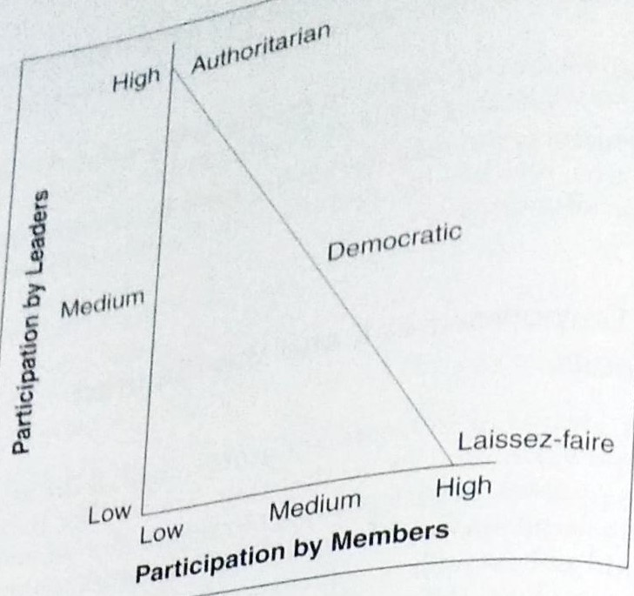
Participation in decision making by leaders & members in groups using three leadership skills:
(Ronald W Toseland and Robert F Rivas, 2012:102)

Slide 35
Decision can be taken alone or by a group depending upon the time, nature of the problem and situation
Merits of Group Decisions (IGNOU, 2020: Unit 12, p.12)
While taking the decisions an individual has limited knowledge, capability, ideas and alternatives. More heads are better than one.
Group decisions are based on more knowledge, experiences and information of several members of the group which improves the quality of decision. It also takes into account more alternatives

Slide 36
As more people are involved in the decision making process, it develops we feeling among the members, which ultimately enhances the commitment, satisfaction and participation level of members to implement the decision
Group decision facilitates personality development and awareness of the members of the group about the on going activities of the agency, so that, they might implement the decision whole heartedly in order to achieve the group as well as the agency goals

Slide 37
Limitations of Group Decisions
(IGNOU, 2020: Unit 12, p.12)
It is time consuming to arrive at a consensus when decision is to be taken by the group due to complexity of the problems, personality differences and politics within the group.
Confidentiality may not be maintained in case of group decisions

Slide 38
Group decision can be dominated by a few members, which ultimately affects its spirit and effectiveness.
In group decision, no body likes to share any responsibility, that is why sometimes it comes out to be a heartless, ineffective and delayed decision.
The problem of group think where members may avoid to be too harsh towards the fellow member could also hinder the group decision making. It is possible when the group is more cohesive.

Slide 39
(Ronald W Toseland and Robert F Rivas, 1984:260-261)
The superiority of group has been less consistently documented when the task to be accomplished is of a more intellectual nature, such as a logic problem
While groups are better than the average individual, they are not better than the best individual. Therefore, a group of novices may perform worse than one expert.
Groups have the advantage of the wide variety of opinions and knowledge, but group members may censor controversial opinions.

Slide 40
Accuracy may be affected by averaging the decision of non-interacting individuals.
When groups solve intellectual tasks, members’ rational information processing orientation may be impeded by socio-emotional concerns.
Because task groups require the time of a number of members who deliberate until they reach a decision, task groups may be more costly than work done by one or more individual working alone

Slide 41
References
Cartwright, D. (1968). The nature of group cohesiveness. In Cartwright, D. & Zender, A. (Eds.). Group dynamics research and theory. (3rd ed., pp. 91-109). New York: Harper & Row.
Festinger L. (1950). Informal social communication. Psychological, 57, 271-282.
Forsyth, D.R. (2010). Group Dynamics (5th ed.). Belmont CA: Wadsworth Cengage Learning.
IGNOU (2020) MSW 008 - Social Group Work: Working with Groups (rev. ed.). New Delhi: School of Social Work, Indira Gandhi National Open University
Konopka Gisela (1963) Social Group Work A Helping Process, Englewood Cliffs, NJ: Prentice Hall Inc.

Slide 42
Kurt Lewin (1948) Resolving Social Conflict, New York: Harper
Pallassana R. Balgopal & Vassil V. Thomas (1983) Groups in Social Work – An ecological perspective, New York: Macmillan Publishing Co.
Toseland Ronald W and Rivas Robert F (1984) An Introduction to Group Work Practice, New York: McMillan Publishing Company
Toseland W. Ronald & Rivas F. Robert (2012) An Introduction to Group Work Practice (7th Ed.). Boston: Allyn & Bacon
Yukl, G. (2002). Leadership in organizations. Upper Saddle River, NJ: Prentice Hall

Slide 43
Thank You

