Slide 1

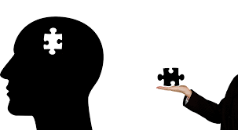
Pharmacological & Non-Pharmacological interventions in Psychiatry
Dr.Tejaswini Miskin
Consultant Psychiatrist

Slide 2
Common Myths about Mental disorders:-
Mental illness is caused by evil spirit or supernatural power.
Mental illnesses are untreatable.
Marriage can cure mental illness.
People with mental illness can never be productive or do normal work like normal people.
Once a psychiatric patient, always a psychiatric patient.

Slide 3
Children don’t suffer from psychiatric illnesses and it is a result of bad parenting style.
Mentally ill patients are violent and dangerous.
Attempting suicide is a sign of cowardice.
One can cure mental illness by yoga, meditation, exercise and becoming strong.
Psychiatric medicines are addictive or habit forming.
Homosexuality is a new age fad and psychiatrist can cure it.

Slide 4
Pharmacological Treatment

Slide 5
Classes of Medications:-
Antipsychotics
First Generation(eg- Haloperidol)
Second Generation(Eg- Olanzapine)
Antidepressants
TCA- eg Amitriptyllines
Anti-anxiety
Benzodiazepines- Short term
SSRIs- eg Sertraline,escitalopram
SNRIs-eg Venlafaxines
SSRIs Long-term

Slide 6
Mood Stabilizers
Lithium
Sodium Valproate
Treatment in drug addiction
BZDs
Anti-craving- Acamprosate
Antidementia
Anticholinesterase inhibitors-Donepezil
NMDA Anta-Memantine
Antabuse- Disulfiram
Treatment in children
  Stimulants- Methylphenidate
  Non-Stimulants- Atomoxetine

Slide 7

Medication is a vital component in the treatment of patients with severe mental disorder. They can reduce symptoms and prevent relapses of psychiatric disorders but it can be a challenge for clinician to motivate patient to stay on medication.

Slide 8
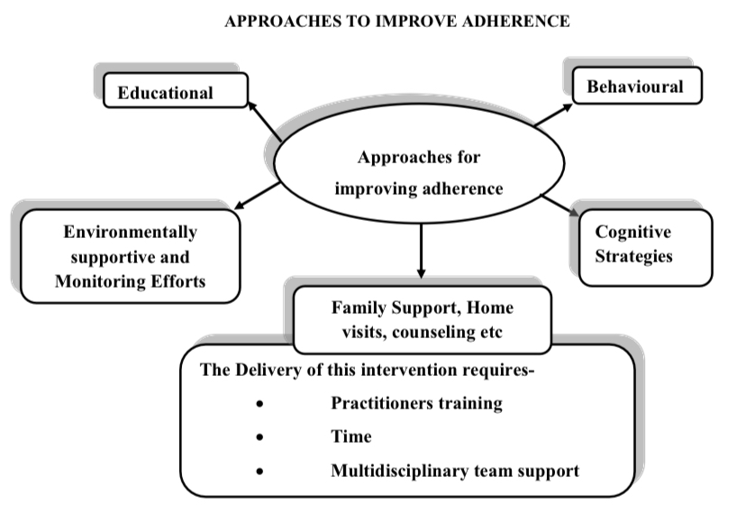

Slide 9
Common Side-Effects of medications:-
Stomach upset
Nausea
Insomnia/over sedation
Tremors
Drooling of saliva
Muscle stiffness
Involuntary movements
Slurred speech
Gait imbalance

Slide 10

Non-Pharmacological interventions – Psychosocial Interventions

Slide 11
Psychoeducation:-
Psycho-Education is the “process of teaching clients with mental illness and their family members about the nature of the illness, including its etiology, progression, consequences, prognosis, treatment and alternatives” (Barker, 2003).
• Relapse Reduction/Prevention
• Increase medication Adherence
• Increase satisfaction with Mental Health service delivery System
• Improve Quality of life
• Overall well being of client & Caregivers

Slide 12
Psychotherapies-
Cognitive Behavioral Therapy
Rational emotive Behavior Therapy
Psychoanalysis
Dialectic Behavioral Therapy
Family therapy
Supportive psychotherapy
Motivation Enhancement therapy
Mindfulness based psychotherapy
Acceptance commitment therapy
Applied Behavioral analysis

Slide 13
Psychosocial Rehabilitation-
“A series of psychosocial and social intervention strategies that complement the pharmacological interventions and management of the symptoms, and whose aim is to improve personal and social functioning, quality of life, and
support to the community integration of people affected by severe and chronic mental illnesses”.

Slide 14
Multi-disciplinary team approach-
1. Care Programmed Approach is a systematic methodology to assess the social and health needs. A Care plan needs to be prepared for each client that identifies the social and health care required for a series of providers that involve regular contact with the case Manager.
2.Intensive Case Management is characterized by a burden of less than 20 patients per case manager (normally one psychiatrist/ Psychiatric Social worker). The ICM (Intensive case management) model is adopted to cover the needs of high frequency patients.
3.Assertive Community Treatment is a form of intervention provided by a team of multidisciplinary mental health team members within the community in an active manner.
4.Day centers and/or psychosocial rehabilitation centers/Half way homes
5.Community Mental Health Centers

Slide 15
Psychosocial Interventions
• To improve the individual functionality.
• To help with relationships and communication.
• Social Skills Training
• Vocational Skills Training
• Cognitive Retraining
• Attitudinal change
• Job placement
• Follow-up services
• Encourages to participate in social role.
Address family burden. Emotional support to caregivers.

Slide 16
Promote early identification of relapse
Develop self-help groups for mutual support and networking among families
• Provide information about services, welfare benefits.
Legal services

Slide 17
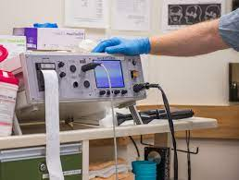
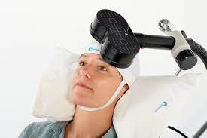
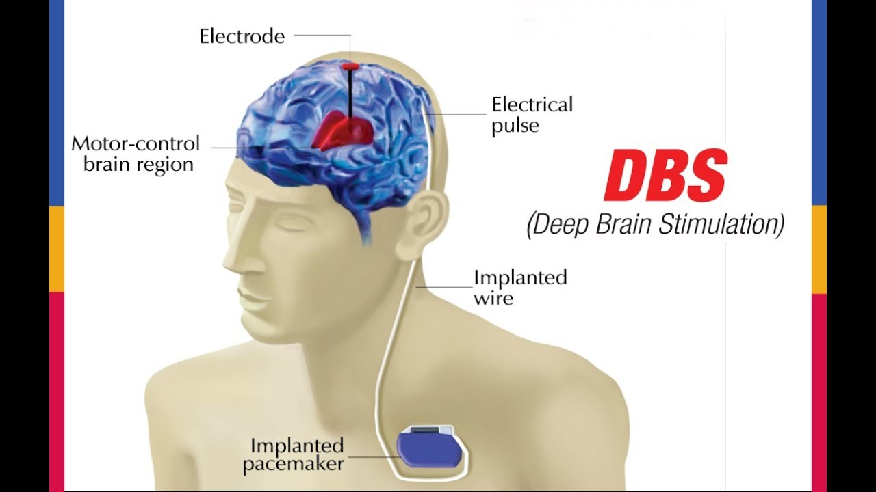
Brain Stimulation Techniques-
ECT
rTMS
DBS
Neurosurgeries

Slide 18

Conclusion:-
Offer your hand, not your judgement.
There is no greater joy nor greater reward than to make a fundamental difference in someone’s life.

Slide 19


